Slide 1
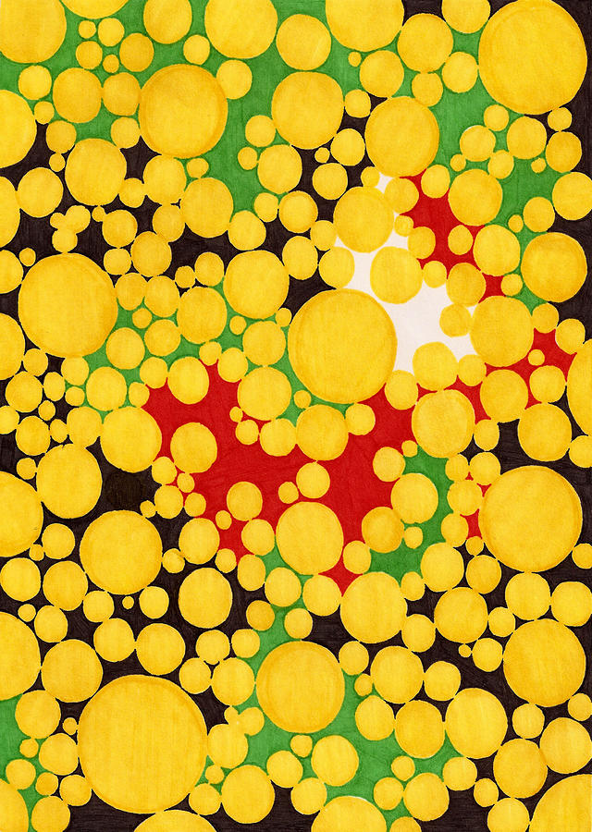
Yellow Fever
Tatiana Giron.
Period: 6

Slide 2
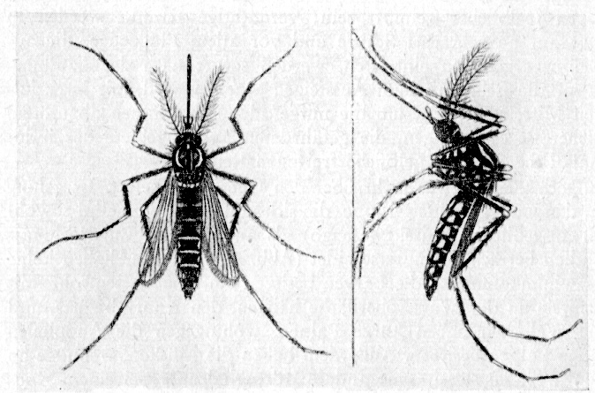
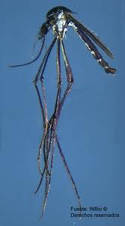
Species of mosquitoes that carry yellow fever.
Aedes aegypti - also called the "Yellow fever-Mosquito"
Haemagogus.

Slide 3
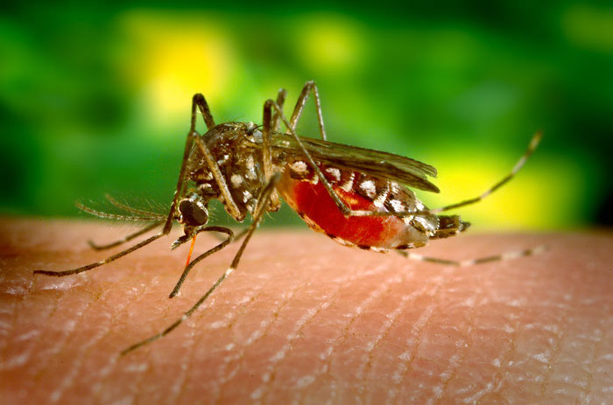
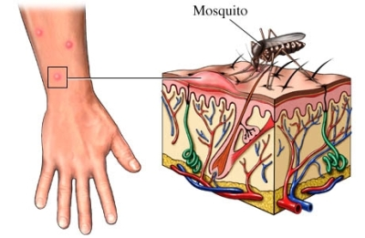
Transmission.
Yellow fever is a disease carried by female mosquitoes of two species (Aedes and Haemogogus species). Mosquitoes pass yellow fever to humans through a small amount of saliva when they bite. The species of mosquito that carry yellow fever are native to sub-Saharan Africa and South America.

Slide 4
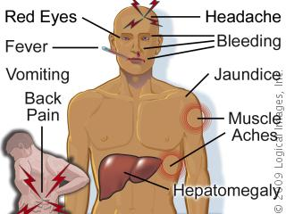
Symptoms of yellow fever.
In mild cases, some people have no symptoms, while others may have a fever, bloody nose, and a slow heartbeat. In more severe cases, symptoms can appear in three stages. Stage 1 usually includes things like a high fever, vomiting, and neck and back pain. In Stage 2 the fever can end and some people recover entirely. Those who progress to Stage 3 will see their fever return and may experience, organ failure, or even death.
Symptoms occur within three to six days after exposure.

Slide 5
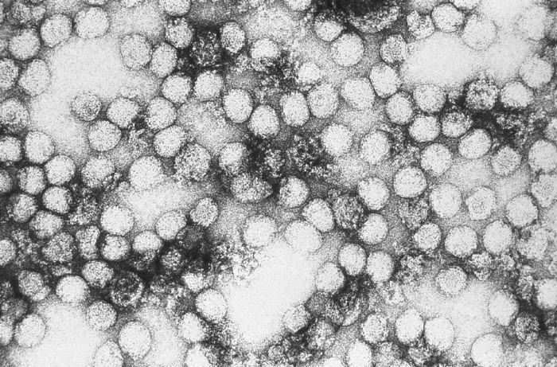
Who gets yellow fever?
This disease can affect both sexes, all ages and races. Jungle yellow fever, of tropical Central and South America, occurs predominantly among adult males 20 to 40 years old who are exposed in the tropical forests.

Slide 6
How does it spread from human to human or does it?
Yellow fever, however, CANNOT be passed from one human being to another. Rather, the virus responsible for yellow fever is transmitted through an intermediate vector—a mosquito—which carries the virus from one host to another.

Slide 7
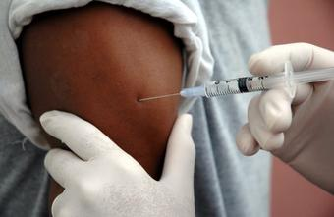
Treatment and Prevention:
-Yellow fever vaccine exists
-Avoidance of mosquito bites (covering of exposed skin/repellent)
-Rest & fluids is crucial to reduce symptoms
-Hospitalization
-No cure exists once acquired

Slide 8
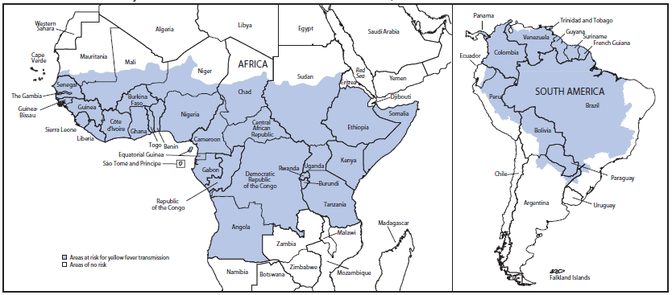
Where was The Yellow Fever found in the world?

Slide 9
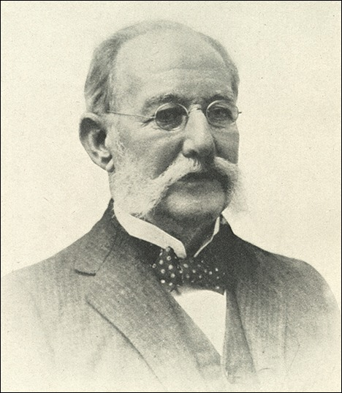
How did they discover it?
Carlos Juan Finlay
discovered yellow fever. This renowned physician was born on December 3rd, 1833 in Cuba.
Discovered how Yellow Fever gets transmitted, via mosquitoes and not through humans.

Slide 10
How many people lives were lost by disease each year?
WHO “(World Health Organization)" officially estimates that there are 200,000 cases of disease and 30,000 deaths a year; the number of officially reported cases is far lower. An estimated 90% of the infections occur on the African continent.
90% of cases occur in Africa, 10% in South America.

Slide 11
List of some websites with this information.
•http://en.wikipedia.org/wiki/Yellow_fever
•http://health.nytimes.com/health/guides/disease/yellow-fever/overview.html
•http://virus.emedtv.com/yellow-fever/yellow-fever-symptoms.html

