Slide 1
Yellow fever
By: Son Le

Slide 2
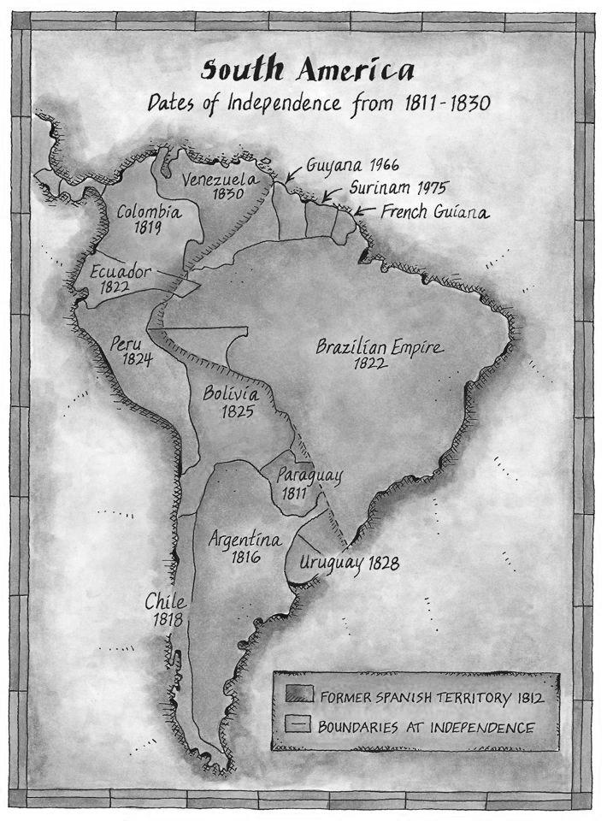
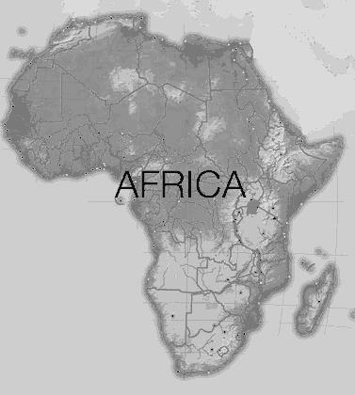
® Fever is found in tropical and subtropical areas in South American and Africa

Slide 3
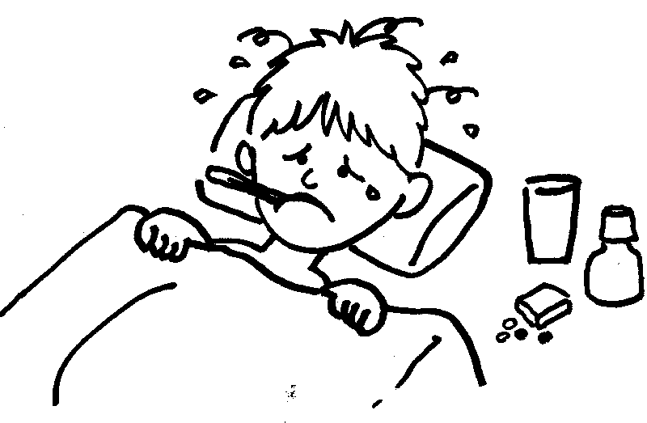
® Yellow fever will began after from 3 to 6 days. Most cases only cause a mild infection with fever, headache, chills, back pain, loss of appetite, nausea, and vomiting.

Slide 4
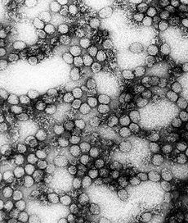
® This is a vector-born of yellow fever. It in the mosquitoes when they bite you and it transmit yellow fever virus into your blood. In some patients, a toxic phase follows, in which liver damage with jaundice.

Slide 5
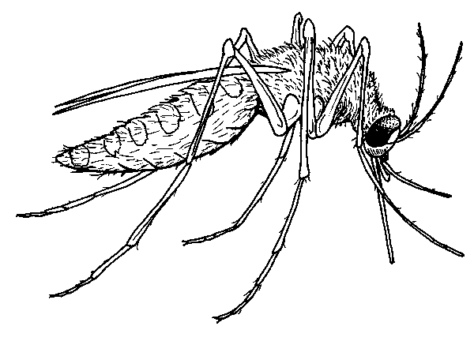
® The yellow fever is the virus transmitted by a bite of female mosquitoes Aedes aegpti.

Slide 6
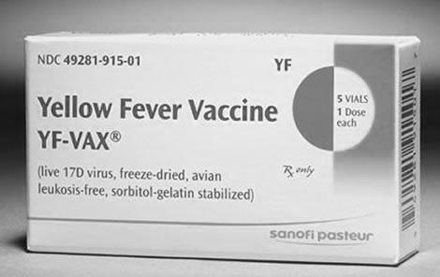
® Since the 1980s, the number of cases of yellow fever has been increasing, making it a re-emerging disease. This is likely due to warfare and social disruption in several African nations. The amount of died people decrease, and American people want everyone to take the shot before going to Africa or somewhere still having fever.

Slide 7
® When the Americans took over the work on the canal in 1904, one of the main efforts had nothing to do with digging and everything to do with keeping the workers healthy. The worst diseases were all spread by mosquito, so a lot of work was done to kill mosquitoes.
® This man has a tank of oil on his back and he is spraying it into ditches to kill mosquitoes.

Slide 8
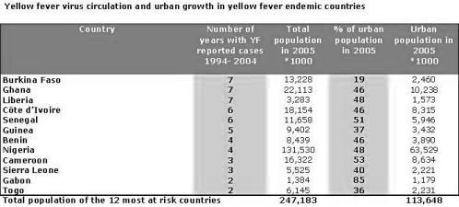
® In 1793 the epidemic depopulated Philadelphia: 5,000 out of a population of 45,000
® There are an estimated 200 000 cases of yellow fever (causing 30 000 deaths) worldwide each year

Slide 9
Links- Google.com Wikipedia.org webmd.com answers.yahoo.com youtube.com

