Slide 1
Yellow fever
By : Chaimae Elayane

Slide 2
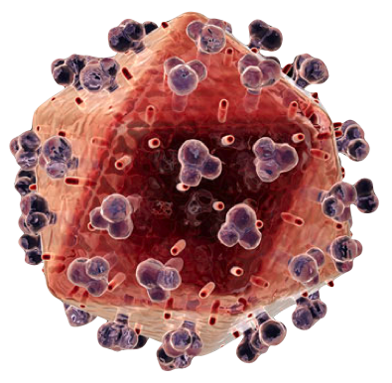
What is Yellow Fever?
yellow fever is a disease that killed tens of thousands of people in the colonies in the late 1700s. It was centralized in Africa, but then slaves came with the Yellow fever and with mosquitoes. There still is Yellow fever around, but there is now a cure and a vaccine made. So there are no worries about coughing up black blood.

Slide 3
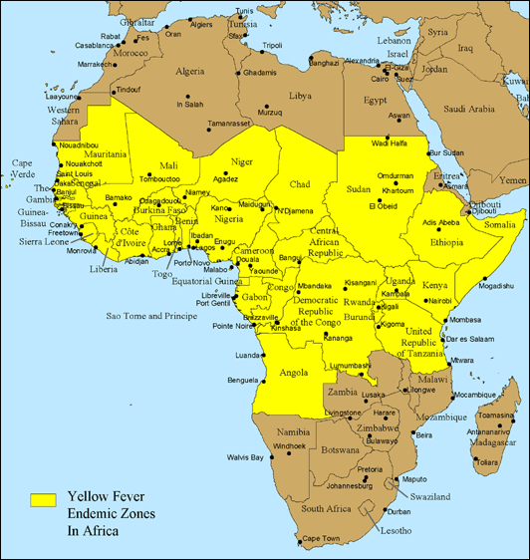
Where did yellow fever originate ?
The origins of yellow fever most likely lie in Africa. It is thought that the virus originated in East or Central Africa and spread from there to West Africa

Slide 4
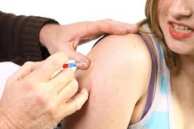
Does yellow fever have a vaccine?
A vaccine that provides immunity to yellow fever was developed in 1939. Vaccination is required for all persons traveling to regions where yellow fever is known to exist.

Slide 5
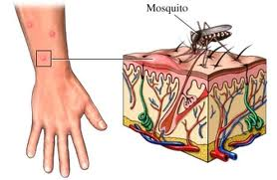
How do you get yellow fever?
People get yellow fever from the bite of an infected female mosquito. The mosquito injects the yellow fever virus into the bite. Symptoms start 3 to 6 days after being bitten by an infected mosquito. Yellow fever is diagnosed by a blood test.

Slide 6
How can yellow fever be spread?
yellow fever is spread through mosquitos. mosquito bites infected person or monkey, then bits another person and that person has contracted virus.

Slide 7
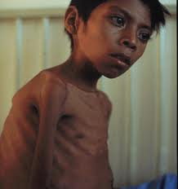
How long does yellow fever take to kill you?
2 to 3 weeks.
Why did the yellow fever happen?
because mosquitos carried the disease and bit people and it spread around

Slide 8
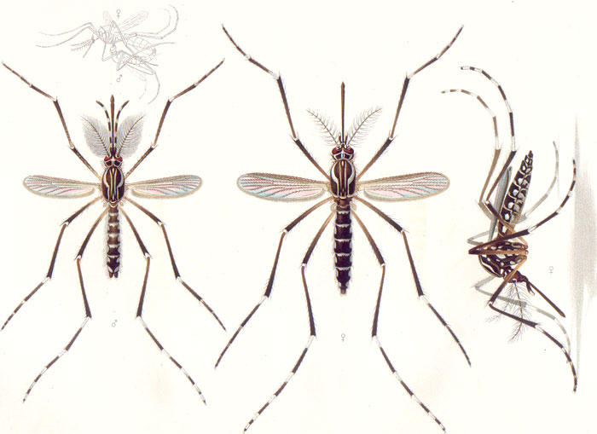
Adults of the yellow fever mosquitoAedes aegypti. The male on the left, females on the right. Only the female mosquito bites can transmit the disease

Slide 9
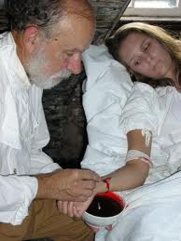
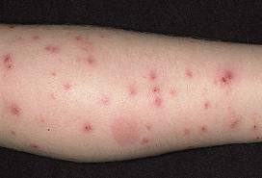

Slide 10
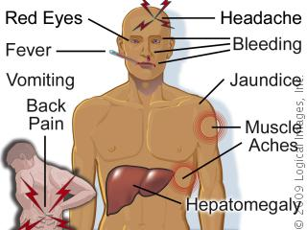
What does yellow fever do?
what yellow fever does to you is that it gives you headaches, muscle aches, vomiting and or nausea. it also causes dizziness , red eyes, face or tongue. more serious causes are brain and or heart dysfunction.

Slide 11
http://www.netdoctor.co.uk www.googleimages.com http://wiki.answers.com

Slide 12
The End

