Slide 1
Trypanosomiasis
By: Chau Phan

Slide 2
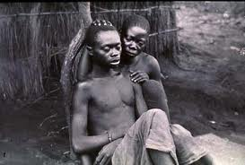
Trypanosomiasis is a disease that cause by the fly that called Glossina.
This disease affect mostly in Africa.

Slide 3
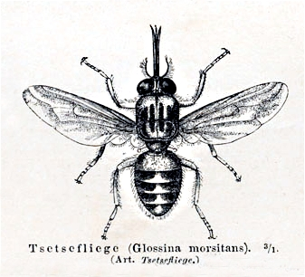
Glossina fly also called Tsetse fly
This fly mostly live in Africa between the Sahara and the Kalahari deserts

Slide 4
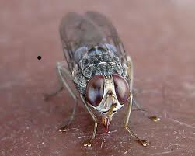
Thy fly will bite human also they transmitted the blood into human blood

Slide 5
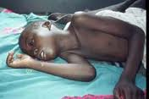
The symptoms of the disease is sleeping and sickness.

Slide 6
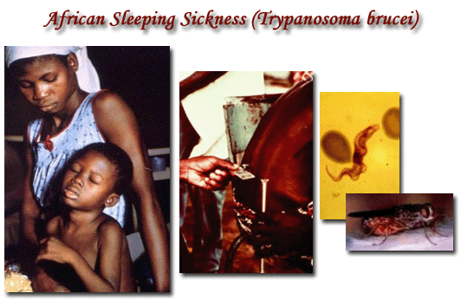
This disease affect everyone in Africa
Also this affect animals too.
This disease not spread from human to human. It cause by the fly.

Slide 7
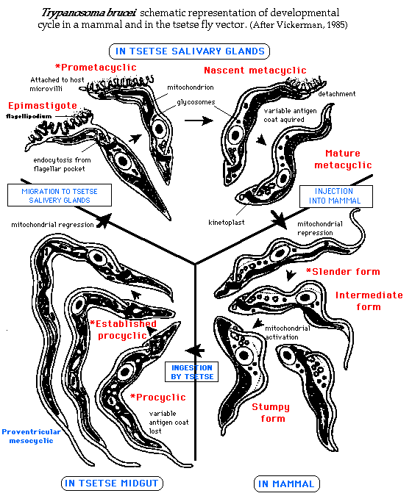
This is a cycle in a mammal and in the tsetse fly vector

Slide 8
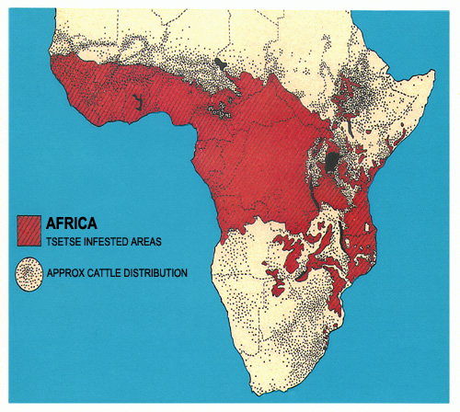
This a map that the disease live in Africa

Slide 9
Covering areas in about 37 countries containing more than 60 million people
About 48,000 people died of it in 2008
The number of reported cases was below 10,000 in 2009

Slide 10
This is all the web site that I found the information:
http://www.microbiologybytes.com/introduction/Trypano.html
http://en.wikipedia.org/wiki/African_trypanosomiasis
http://en.wikipedia.org/wiki/Glossina

Slide 11
THE END

