Slide 1
Tin Truong
Per.6
HR: 661

Slide 2
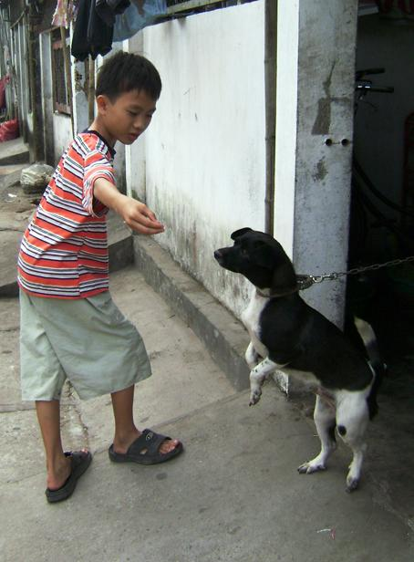
What is Toxocariasis ?
Toxocariasis is an illness of human caused by a dog. Usually affects kids under age 10.

Slide 3
History about Toxocariasis
Toxocariasis is a rare infection caused by roundworms. It was first recognized to be associated with dog in the 1940s. It typically affects the children and can lead to profound monocular.

Slide 4
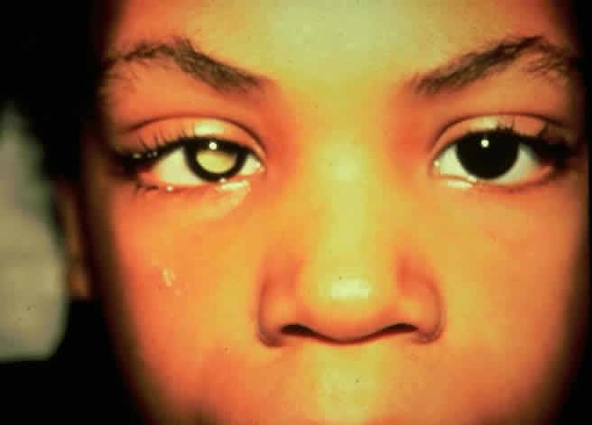
What is Toxocariasis symptoms ?
Many kids won't have symptoms. But if they do, they can include fever, cough, wheezing, spleen or enlarged liver.

Slide 5
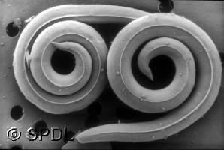
How can kids get Toxocariasis?
Eggs from the worms pass into the feces of dog, then pass to area around the home where the kids play.

Slide 6
Who is at risks of Toxocariasis?
The owners of dogs or cats.

Slide 7
What is treatment for Toxocariasis?
A child who caused by Toxocariasis should be given medicines as prescribed by your doctor.

Slide 8
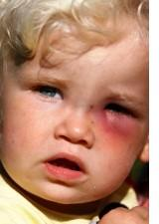
What should you do, when you get caused by Toxocariasis ?
You should called doctor, when your child has any of the symptoms of Toxocariasis includes:
. Fever
. Cough
. Wheezing
. Spleen

Slide 9
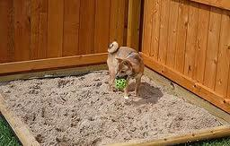
Toxocariasis prevention
. Keep kids aways from areas where the dogs play.
. Reminding kids to wash their hands often
. Keep pets away from sandbox and covered when its not been used.

Slide 10
Where i found information about Toxocariasis ?
. Google.com
. Kidshealth.org
. Answers.yahoo.com

Slide 11
The End

