Slide 1
THE WIFE OF BATH’S TALE
MARTIN RAHEEM
10/14/2014
Brit.Lit/3 PERIOD
Martin R Barshawee

Slide 2
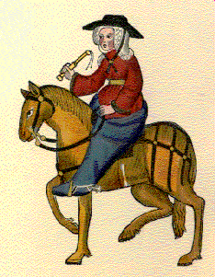
The Wife of Bath’s
A wealthy woman who made her money from making clothes.
She sewed the clothes by her hands.

Slide 3
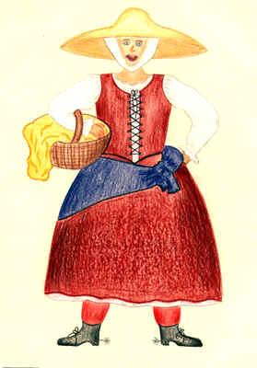
Character description
The wife of bath called Her self Alyson and Alys.
Bath is not her husband name, its a name of an English town.
Largish woman with gap teeth and a big hat that looks like a boat.

Slide 4
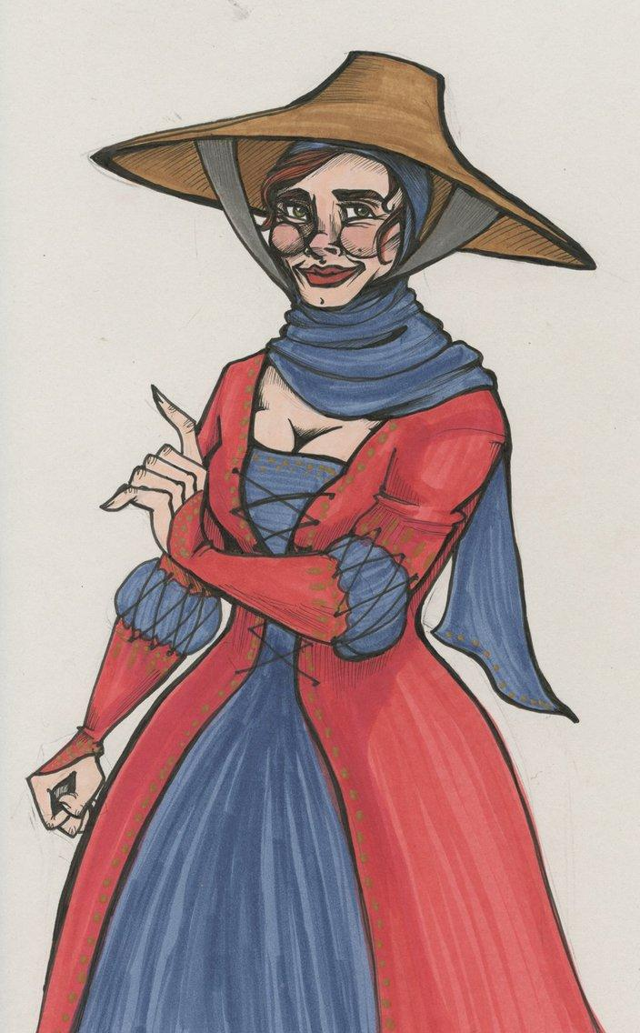
Character description
Alyson was from England and her clothes were expensive.
Her clothes were colorful,the leather on shoes was new.
Her bright clothes showed how wealthy she is.

Slide 5
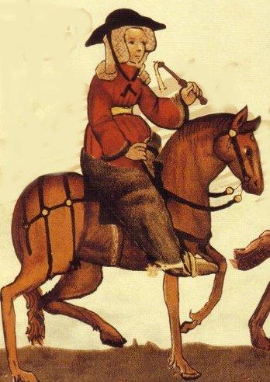
Character description
Alyson married her first husband when she was twelve years.
The wife married more than four times.

Slide 6
Character description
Jankyn was her fifth husband who she loved the most.
Jankyn punished her everyday but she controlled him by her sexual power.
Jankyn was twice her age

Slide 7
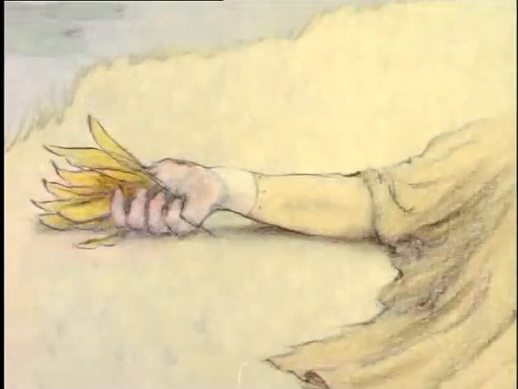
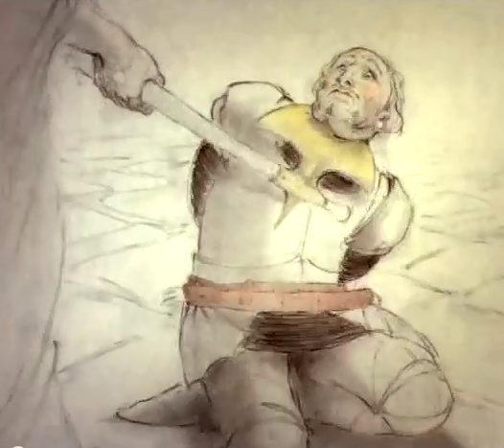
The Wife of Bath
A young knight in rapes a woman. The Queen heard about it and decided to cut his head off or find an answer to her question.

Slide 8
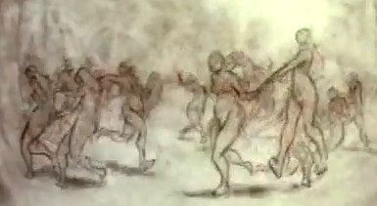
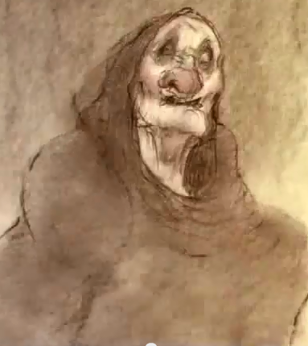
The Wife of Bath
The knight saw 24 maidens dancing. When he went to them, they disappeared and just stay the old woman. He asked her the question and promised him to answer the question if he do what she asks him.

Slide 9
The Wife of Bath
The knight Agrees with her deal. He went to the queen and he answered correctly.
The question was what most women desire? they desire sovereignty over their husbands.
The old lady asked him to marry her. The knight agrees with sadness.

Slide 10
The Wife of Bath
The knight married her but he confesses about her age. She keeps saying she loves him true love.
The knight prefers to have a beautiful wife and he can trust her.

Slide 11
The Wife of Bath
She offers him a choice: an old ugly lady, Loyal and he can trust her. Or a beautiful woman. He answered her saying the choice is yours.She asked him to kiss her and he will find both. He kissed her and she turned to a lovely young woman. And they lived happy all their life.

Slide 12
The Canterbury Tales : Reference List
http://en.wikipedia.org/wiki/The_Wife_of_Bath%27s_Tale
http://www.sparknotes.com/lit/canterbury/characters.html
http://www.cliffsnotes.com/literature/c/the-canterbury-tales/summary-and-analysis/the-wife-of-baths-prologue-and-tale
http://www.sparknotes.com/lit/canterbury/section10.rhtml

