Slide 1
Asif Nafiz
The squire's tale

Slide 2
The Duties of a Medieval Squire
The squire’s job was to maintain and care for all the knight’s belongings, including his horse and armour, a knight’s most important possessions for fighting and jousting.Maintaining the knight’s armour and looking after his horse were important training for when the squire was eventually out on a battlefield, as a knight. The squire was expected to be with his knight throughout the day, helping him to dress, serving him at table, running errands and messages and sleeping by his door at night, ready to help fight off any intruders.

Slide 3
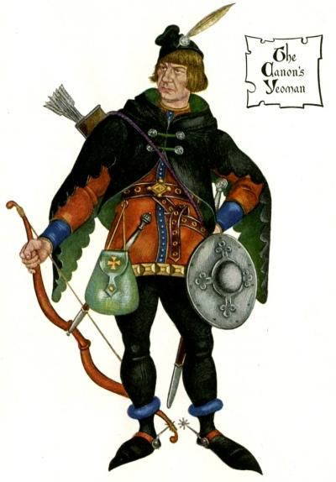
character of squier tale
Chaucer describes his lokkes crulle as they were leyd in presse, average height, great strength, Of twenty yeer of age he was , bravery and cleverness. The author illustrates Squire's youth as fresh as is the month of may.. The dress of the squire is colorful, embroidered with flowers, short with large sleeves. He is very talented, too. He is also be described as a policemen of today

Slide 4
Basic information
There once lived a king named Cambuskan at Tzarev, in Tartary. He was continually engaged in expeditions against Russia and was known far and wide for his excellent qualities. He was brave, rich, wise, just, gentle, honorable, young, strong, lively, handsome and strong of character. This great king had two sons named Algarsyff and Cambalo and his wife Elpheta. He also had an beautiful daughter named Canace who was the youngest of his children.

Slide 5
The Squire's Introduction and Tale:
The Squire's tale is about a royal family. The father, king Cambyuskan, receives a knight in his royal hall during a feast, who gives him certain magical presents. One of the presents is a ring that gives the bearer the power to communicate with birds and the knowledge of the healing powers of every herb in the wood. The king's daughter Canace bears the ring when she walks through the park and rescues a female falcon who has wounded itself. The falcon says that her husband, a male falcon, has been unfaithful to her and has treated her really badly. Canace nurses the falcon with herbs from the wood and takes the falcon home. The other magical presents are a war-horse, a mirror and a sword. The Squire's tale is not finished and looks loosely structured. Several plotlines are announced and preluded, but not further elaborated.

Slide 7
