Slide 1
The Squire’s Tale

Slide 2
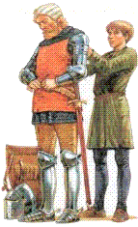
What is a squire’s job?
A squire’s job is to help the knight put his armor on and fix it if it’s broken. He also carries the knight weapons such as his sword and his shield.

Slide 3
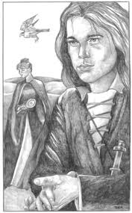
In the Canterbury tales, Chaucer describes the squire as a young handsome man.

Slide 4
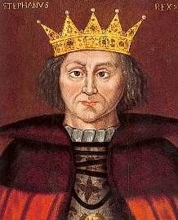
King Cambuskan, A noble King

Slide 5
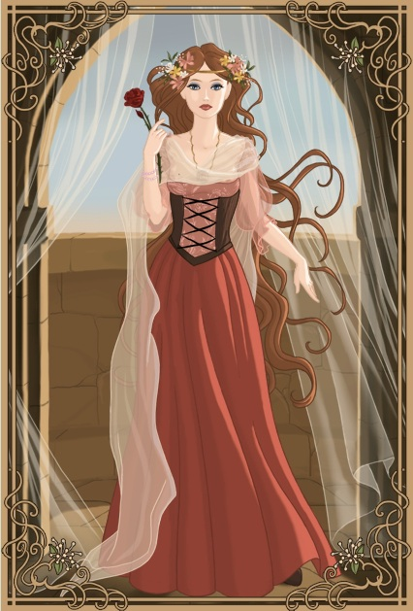
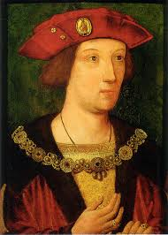
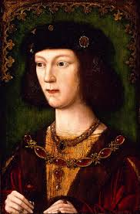
Princess Canace
Her two brothers

Slide 6
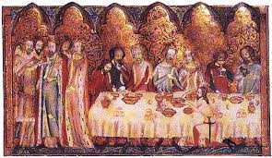
A feast was happening in King Cambuskan’s castle

Slide 7
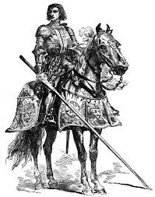
A unknown knight came to the feast bearing a gift from King Araby

Slide 8
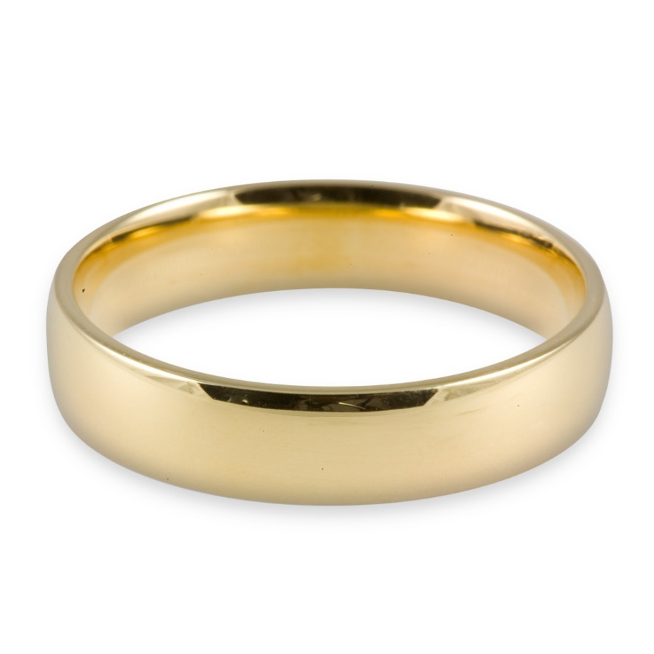
A ring

Slide 9
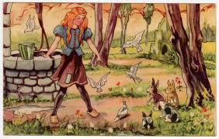
The ring had a special power

Slide 10
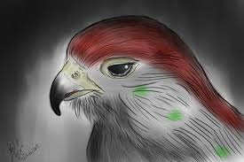
She over heard a Crying Lady Falcon

Slide 11
Character description
http://csis.pace.edu/grendel/projs4a/squir1.html
Summary of the tale
http://www.cliffsnotes.com/literature/c/the-canterbury-tales/summary-and-analysis/the-squires-prologue-and-tale

