Slide 1
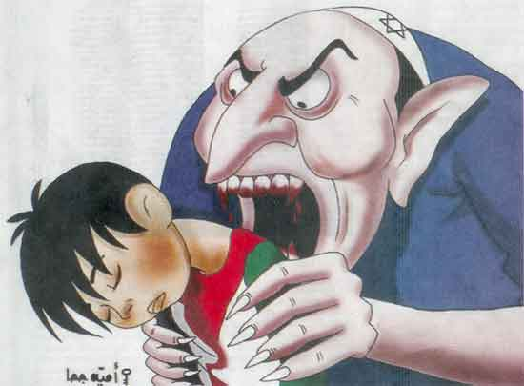
The Prioress’s Tale
By: Suman Askari

Slide 2
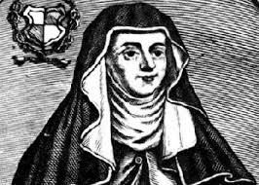
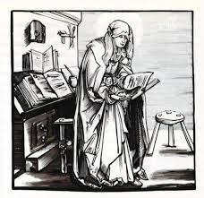
Job Description
A prioress was the head
of a group of nuns. She was
responsible for managing
the activities of the nuns,
both religious and not. She administered discipline,
made decisions on housing, work.

Slide 3
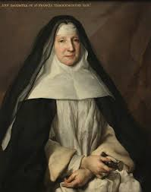
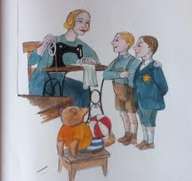
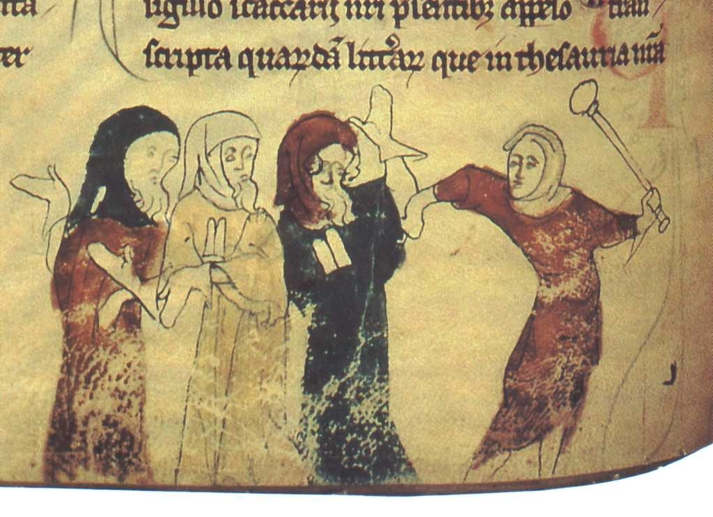
Character Description
Narrator of the story
Who is Prioress?
Prioress is a woman. She has all these funny habits, like singing through her nose, speaking incorrect French, and eating so carefully that she never spills a drop. Her story is of a child killed by Jews, a common theme in medieval Christianity.

Slide 4
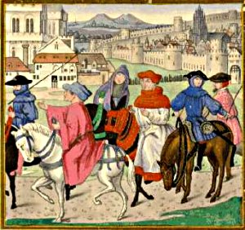
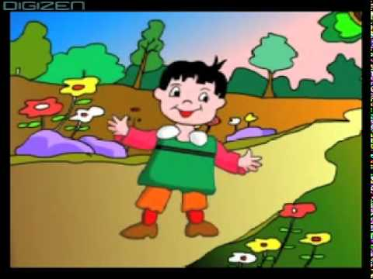
Beginning of the story…
Jews in front of the Christian school
Singing the new song boy learned in school
Kid learned new poem called
“Alma Redemptoris

Slide 5
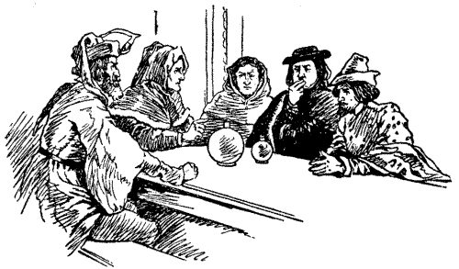
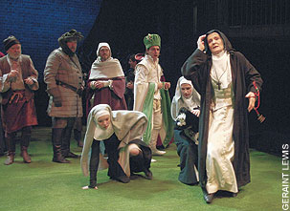
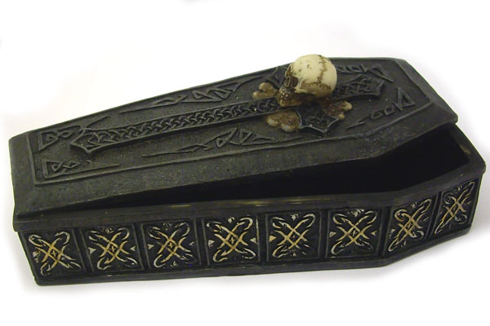
Satan telling Jews to kill that 7 year kid
Looking for her missing child
Buried

Slide 6
What I learned from the story….
I learned that if you hate someone doesn't mean you have to kill him/her. God is always watching you and no matter what happen God is watching and he will always help you.

Slide 7
Resources
http://www.cliffsnotes.com/literature/c/the-canterbury-tales/summary-and-analysis/the-prioress-prologue-and-tale
https://machias.edu/faculty/necastro/chaucer/translation/ct/17prt.html
http://sites.fas.harvard.edu/~chaucer/canttales/priort/
http://www.shmoop.com/canterbury-tales-prologue/the-prioress.html

