Slide 1
The CANTERBURY TALES
THE PARDONER’S TALE
By Geoffrey Chaucer
CHARACTER AND JOB DESCRIPTION
-Shaziya Rubeen

Slide 2
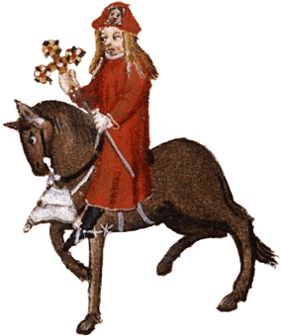
The Pardoner
Theofciaoff authorized to sell indulges for their sins,nothing but the church pardons.
OFFICIAL ORGANISED TO SELL INDULGES

Slide 3
P
A
R
D
O
N
E
R

Slide 4
JOB DESCRIPTION OF A PARDONER IN THE MIDDLE AGES
-The Pardoner was just someone who collected money on behalf of a religious foundation,he worked under the authority of a bishop.
-He should introduce himself to the church congregation;show his letters of authority and make an appeal in aid of some worthy cause approved by the bishop.
-He would then take the money back to the bishop and use for good purpose.
-They did these works of mercy and were beneficial to everybody and sometimes there was no problem with Pardoners.
-Some of them were fraud and were corrupt too.

Slide 5
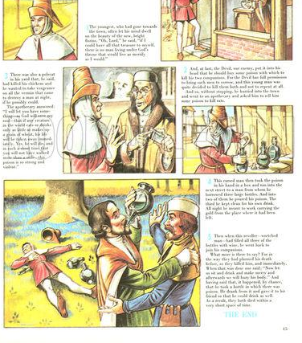

Slide 6
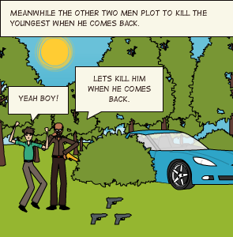
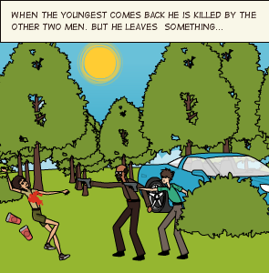
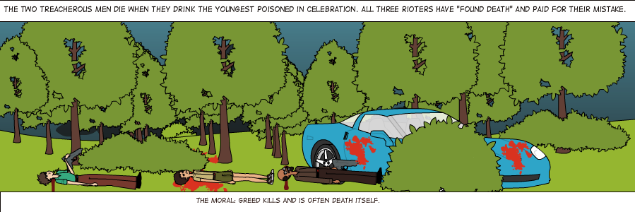

Slide 7
Greed is the root of all evil
PARDONER OF CANTERBURY TALES
Many Pardoner’s including this one collected profits, in fact chaucer’s pardoner excels in fraud, he has long greasy yellow hair.
His one and only interest is to fill his pockets.
Later.his eyes gets opened,he says everybody must beware of sin which can bring only death and sadness,though Pardoner sacrifices his good to cure the sin of others but what he loves most is money and the comforts it brings him.
His tale shows the disastrous effects of greed though he even argued that many sermons are products of his evil intentions.

Slide 8
PARDONER’S CHARACTER AND ATTIRE
The Pardoner exploits innocent people’s love of God and trades on their guilts and doesn’t do a honest work.
The Chaucer’s Pardoner goes through the appearance of absolving people from their sins and deceiving people in this way was a sin.
Clothing, especially for clerics was more uniform than now,the wearing of hoods was a part of a cleric’s ordinary dress.
The Pardoner’s lack of a hood(though he does wear a skullcap) was unorthodox,as was his long hair.
His glaring eyes might have suggested a lustful nature.

Slide 9
RESOURCE
Resource: Mrsalfred.com
British literature ESL- Canterbury Tales
http://www.mrsalfred.com/the-canterbury-tales.html
Google-Role of a Pardoner
http://crossref-it.info/textguide/The-Pardoner's-Prologue-and-Tale/12/1375

