Slide 1
The Pardoner’s tale
By: Imran Siddique

Slide 2
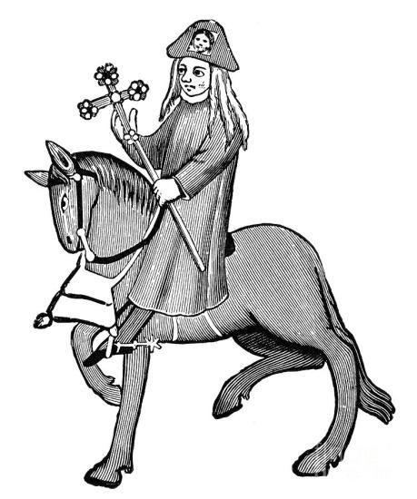
Pardoner’s Job
The Pardoner granted indulgences for people who repented their sins.
He also received money which was “charitable act” from the confessions.

Slide 3
Pardoners characteristics
The Pardoner was a untrustworthy person.
Mostly for the reason that he carried false relics to Canterbury. The relics were crosses with stones to make them heavy and jar full pig bones that he passed on as saints relics.
He cashed in on religion by selling materials.
The Pardoner pocked money that was given to the church.

Slide 4
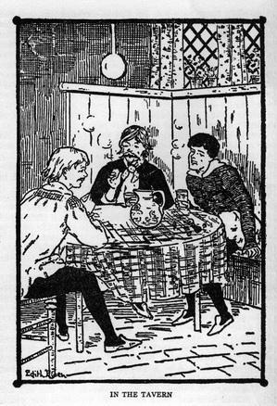

Slide 6
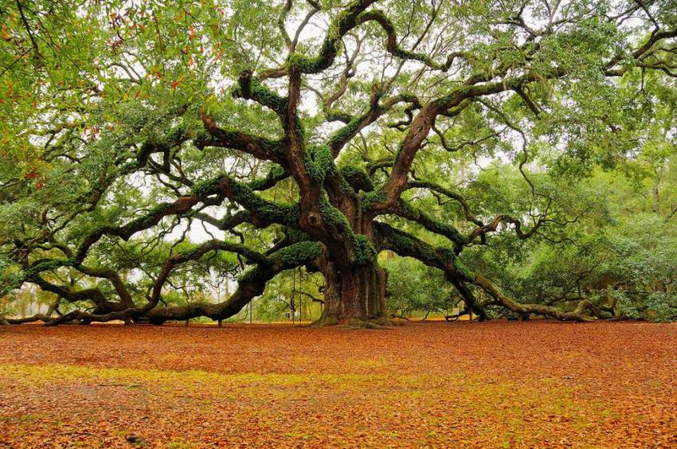

Slide 7
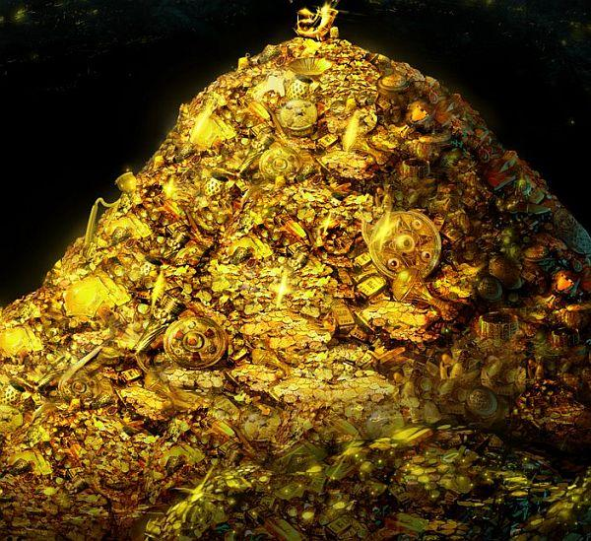

Slide 9
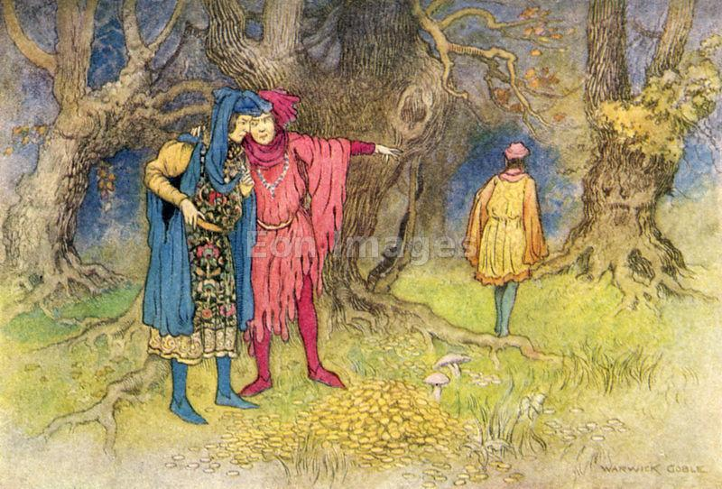

Slide 10
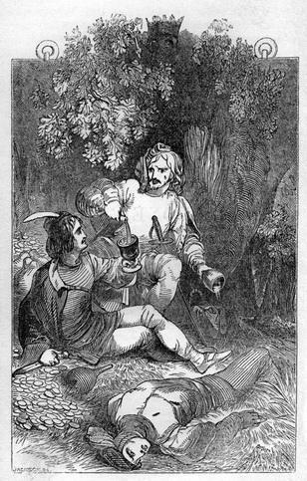

Slide 11
Reference
(n.d.). Retrieved October 17, 2014
The Pardoner's Tale. (2014, October 16). Retrieved October 17, 2014.
What is a pardoner. (n.d.). Retrieved October 17, 2014

