Slide 1
The Pardoner
A Pardoner in 14th century was someone who collected money on behalf of the church. Pardoners usually worked under Bishops. The idea was the Pardoner would go to church show identification and collect money. The money would be taken back to the Bishop and used for a worthy cause like schools, hospitals, roads, etc.
Pardoners would also sell indulgences (forgiveness) for peoples sins and made money that way. They weren't suppose to preach but they did either way.

Slide 2
Pardoner in the Canterbury tales.
This Pardoner was a did a combination of preaching and selling indulgences. His sermon topic always remains the same: Radix malorum est Cupiditas, or “greed is the root of all evil.” He had a bag full of relics(artifacts) which he admitted in the beginning were fake. He took a sheep's bone and claimed that it had supernatural powers and could heal any problem. The people believed him and gave money to the relics which the priest used for himself. He only preached for money not to correct sins. He preached that problems were caused because of evil intentions. By preaching he got revenge on people who ever went against him and stuff.

Slide 3
The Pardoner was a really shallow guy instead of helping other he would only spend on himself. He would take the last penny from a widow and her starving children rather than giving them any of his own. He had a prosperous life . He presented himself as someone of ambiguous gender and sexual orientation. Not even the narrator was sure about this one. He even brought his work tools with him (indulgences n stuff) not only that he also tries to sell them but its strictly forbidden by the host. Overall he was messed up.

Slide 4
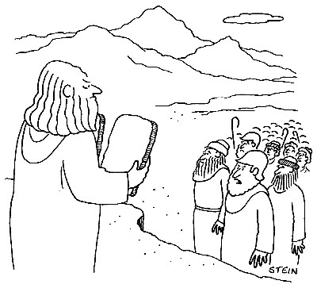
The pardoner’s tale

Slide 5
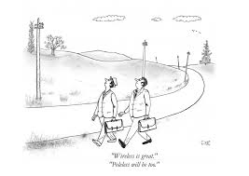

Slide 7
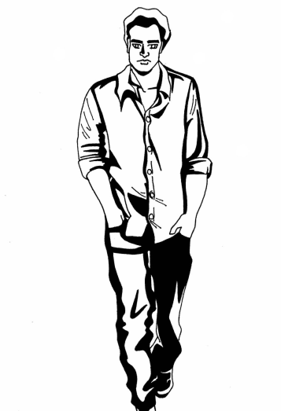

Slide 8
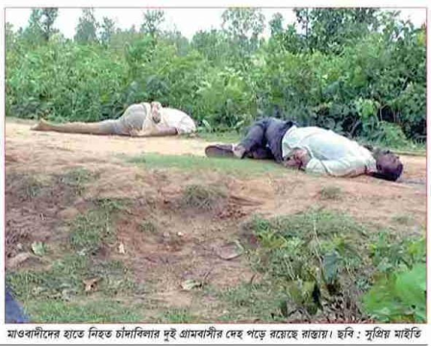

Slide 10
Bibliography
Pardoners tale and biography: Spark notes
http://www.sparknotes.com/lit/canterbury/section11.rhtml
Pardoner in 14th century:cla.edu
http://cla.calpoly.edu/~dschwart/engl430/pardoner/whatsapardoner.html

