Slide 1
Canterbury tales nun’s priest tale
By: Daniel Eisabiglou
Mrs.alfred

Slide 2
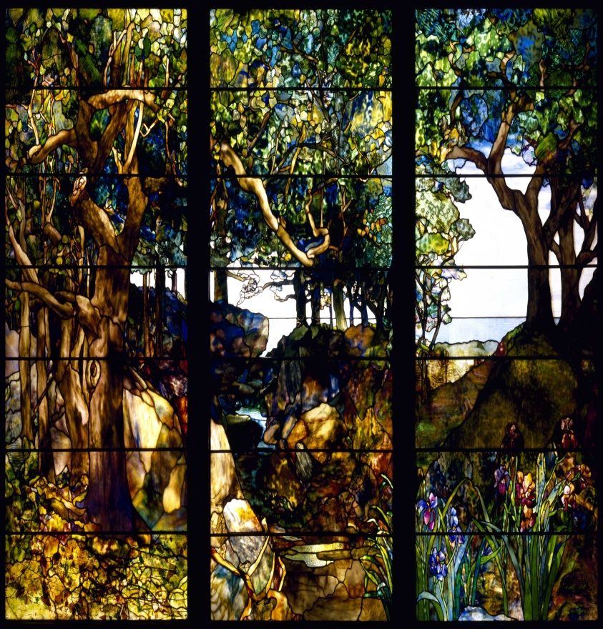
Where the story comes from?
It comes from a victorians stained glass by clement james heaton

Slide 3
Who are the characters?
This storie or fable concerns a world of talking animals who reflect like humen.
The characters are a rooster named chauntecleer .A hen named pertelote.
and a fox .
…………………………………………………………………………
They were living in a barnyard wich the story happrns there.

Slide 4
The story…
Chauntacleer was asleep and dreaming his aproaching doom in form of a fox.
He woke up and he was scared to death.
He wakes his wife pertelote and tells the whole story to her .
but pertelot gets angry to paying heed to a simple dream.
BUT…….

Slide 5
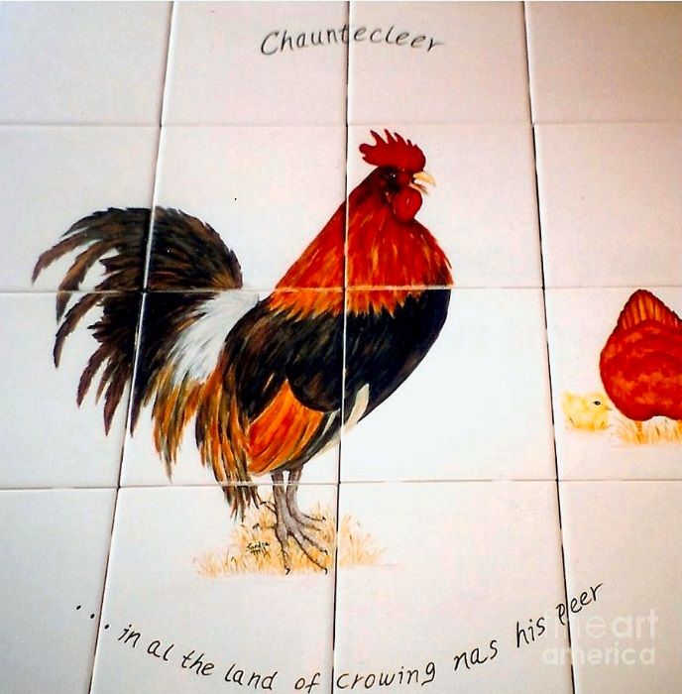
THE DREAM BECOME TRUE…
A col-fox was waiting outside to catch him
just like his father and mother.

Slide 6
Fox catches the chantacleer…
The fox cathes the chanticleer by asking him to crow .
When leaving the barn yard the animals chased them
Chantacleer suggested him to to stop persuers .
When the fox wants to open his mouth to say if he agrees with him or not chantacleer flyes to nearest tree and ran

Slide 7
Chantacleer ran away…

Slide 8
The main part of the story……..
The fox tries to catche him again and make him come down the tree but chanticleer says:
I’m not going to fall to same trick again
Suddenly the people who were trying to chase him arrived and fox has no choice but running away…
So…….

Slide 9
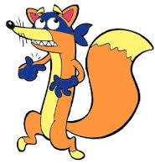
Golden sentence
“Don’t be fool twice by the same trick”

Slide 10
The end

