Slide 1
The monk’s tale
Hannah gyimah
Period: 3

Slide 2
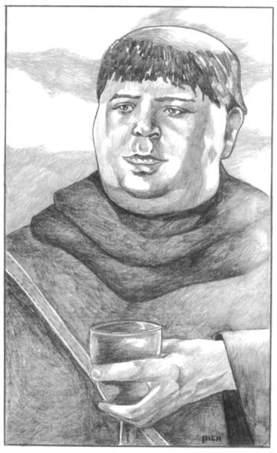
Job description
The monk’s job was hunting, rides horses , loves to eat, loves expensive fur and gold jewelries.

Slide 3
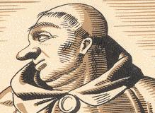
Character description
Fat
Bald
Rebellious
Ignores rules

Slide 4
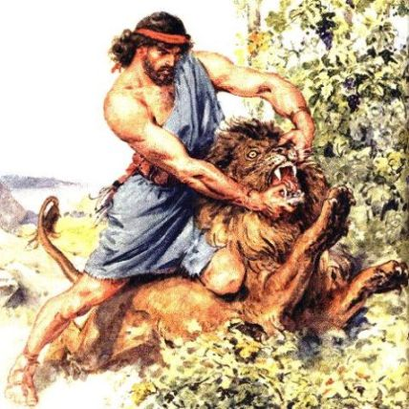
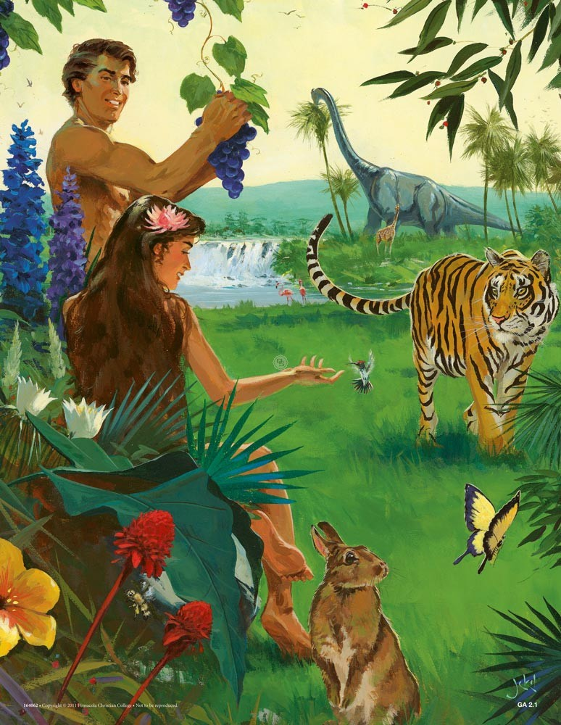
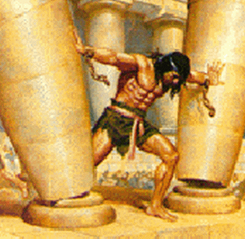
Lucifer /Adam and Samson

Slide 5
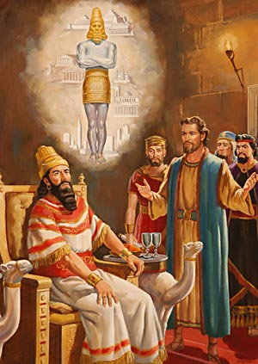
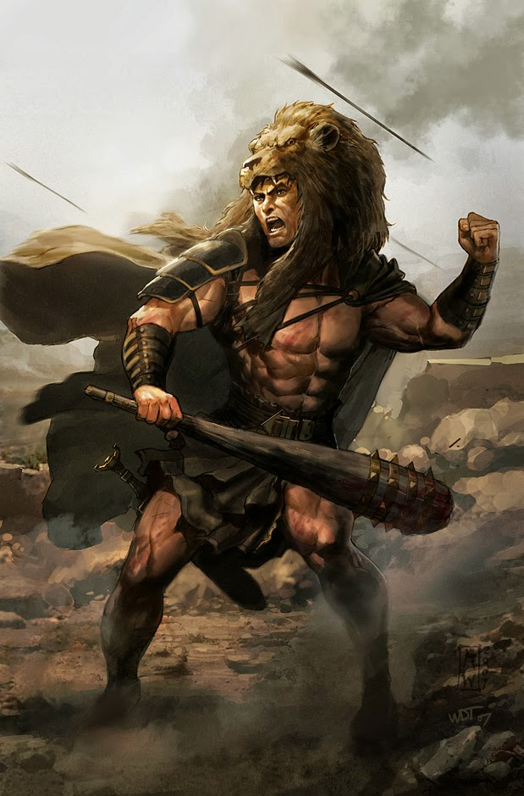
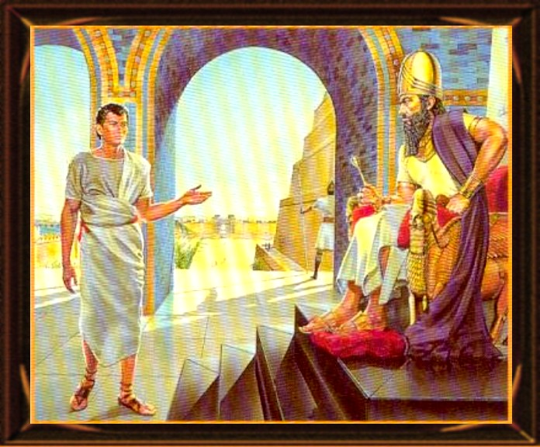
Hercules and Nebuchadnezzar

Slide 6
reference
The monk’s tale:
http://machias.edu/faculty/necastro/chaucer/ct/mkt/
http://eleusinianm.co.uk/redShalfleet/rs29monks.html
http://www.librarius.com/canttran/monktrfs.htm
http://en.wikipedia.org/wiki/The_Monk%27s_Tale

