Slide 1
The Manciples tale
by Sebastian Almaraz

Slide 2
What is a manciple tho??

Slide 3
A manciple......
A manciple in the middle ages was the person in charge of purchasing and storing food for an institute today the word manciple is occasionally used to describe some food management jobs

Slide 4
what does a manciple look like in this tale
in this tale it says that he's wearing a long cotton tunic with long sleeves, and it also says that hes a smart even though hes not well educated. He's a purchasing agent for a large company of lawyers and hes more knowledgable about the market and investment then any of them.

Slide 5
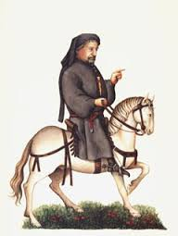
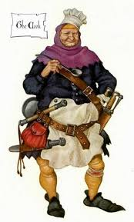
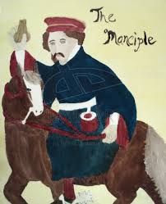
Characters
In this tale theres 3 characters the host, the cook and the manciple

Slide 6
Summary of the tale
The host wanted to hear a story so he turns to the cook which was asleep and drunk on his horse and the tried to wake him up but he accidently dropped him. Then the manciple criticizes him of how drunk he was the n the host asks him to tell a tale. The manciple then tales the tale of the white crow, in this tale Phoebus has a crow that is all white and can talk. Phoebus has a wife who he loves and did anything to please her but he was very jealous so he would watch her suspiciously. But the wife had another lover of low class and one day the crow reveals their secret to Phoebus. Phoebus then kills his wife but regrets it so he blames the crow, cursing it with black feathers and an ugly voice. The manciple then ends the story saying, its best to hold ones tongue and not to say something malicious even if its true.

