Slide 1
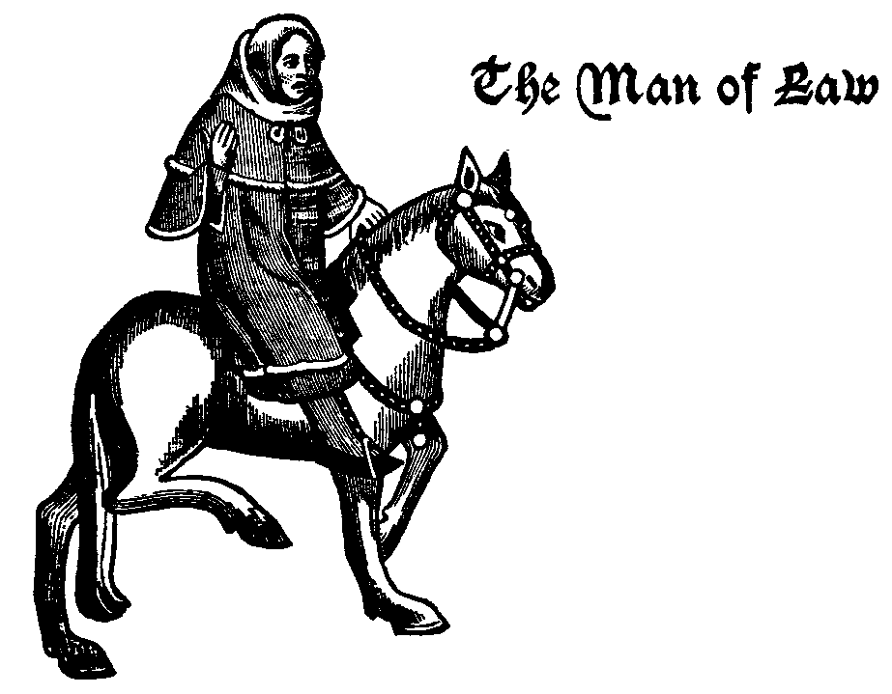
THE MAN OF Law’s Fadi ilias
period: 3 British In Lit

Slide 2
Job description
He is a judge in the court of assizes by letter of appointment from the king, and because of his high standing receives many grants.
He tells a Romance tale of a Christian princess named Custance who is betrothed to the Syrian Sultan on condition that he convert to Christianity.
The Man of Law rides horse in informal.
He is the fifth of the Canterbury Tales.

Slide 3
Character description
The man of law’s is a judicious and dignified man.
The Man of Law known as The Sergeant at Law.
The Man of Law's called The Lawyer's.
He wear silk adorned clothes.

Slide 4
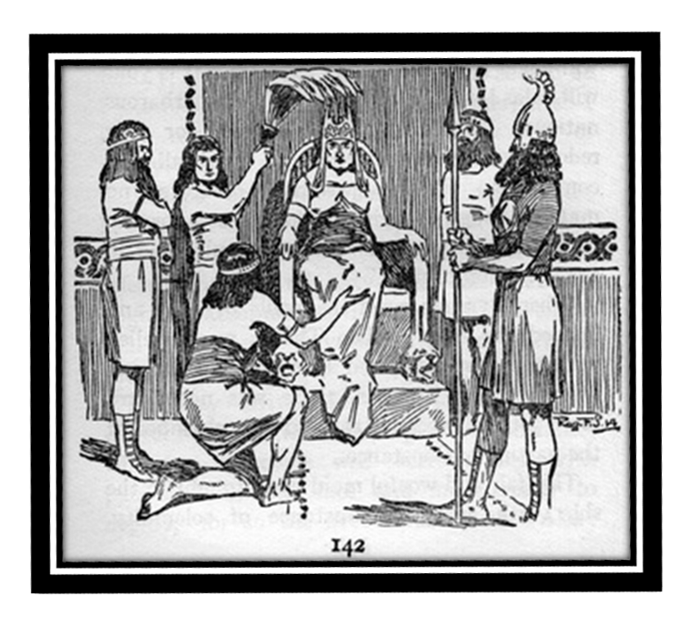
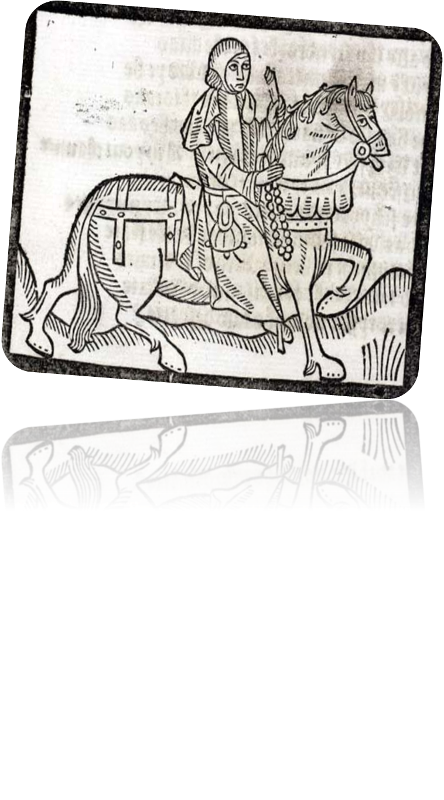
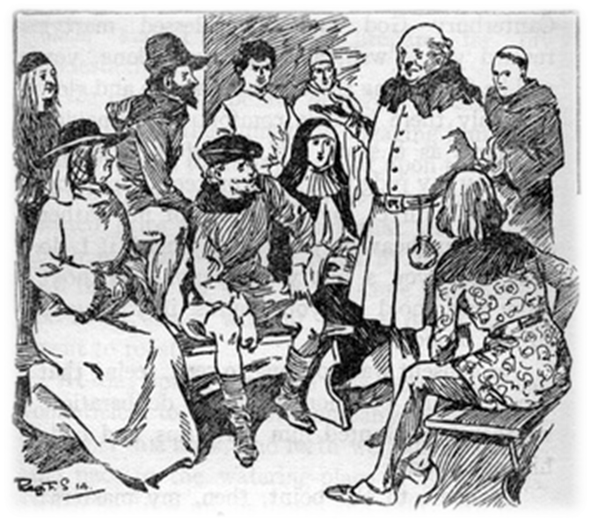

Slide 5
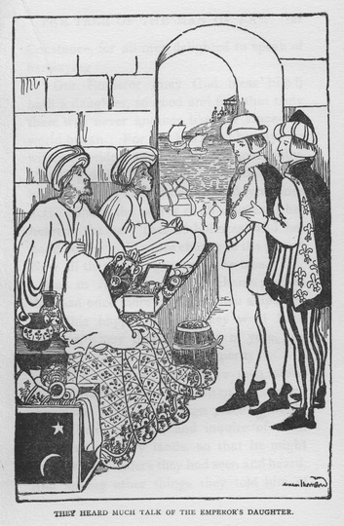
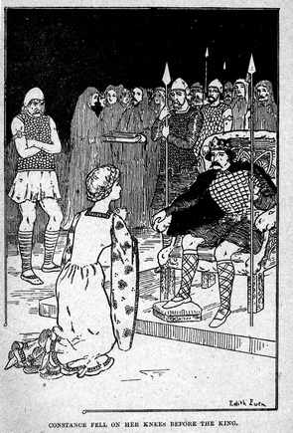
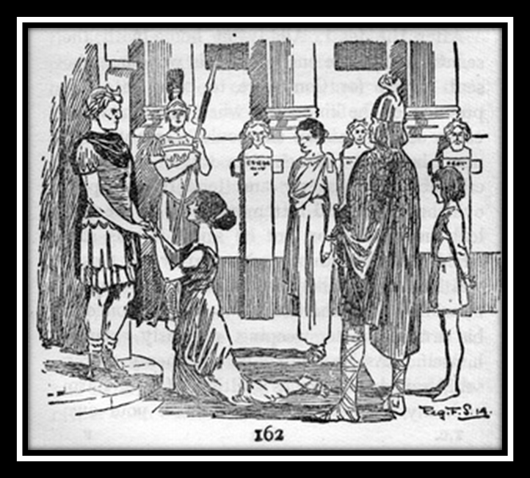
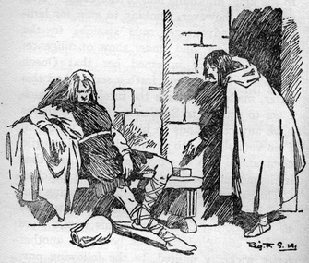

Slide 6
http://chaucereditions.wordpress.com/1910s/1930s-edition-of-clarkes-tales-from-chaucer/
http://en.wikipedia.org/wiki/The_Man_of_Law's_Tale
http://www.cliffsnotes.com/literature/c/the-canterbury-tales/summary-and-analysis/the-man-of-laws-prologue-and-tale
http://www.gradesaver.com/the-canterbury-tales/study-guide/section6/
https://www.google.com/search?q=the+man+of+law%27s+tale&safe=strict&biw=1242&bih=606&tbm=isch&source=lnms&sa=X&ei=U5ZBVKDqIoSjyATz5YDoDA&ved=0CAgQ_AUoAA

