Slide 1
The Canterbury tale
By: Toan Ngo
The Knight’s Tale

Slide 2
What is a knight
is a person granted an honorary title of knighthood by a monarch or other political leader for service to the Monarch or country, especially in a military capacity
a knight was a vassal who served as a fighter for a lord

Slide 3
Character information and they job

Slide 4
Theseus
A great conqueror and the duke of Athens.
The most powerful ruler in the story, he is often called upon to make the final judgment, but he listens to others’ please for help.

Slide 5
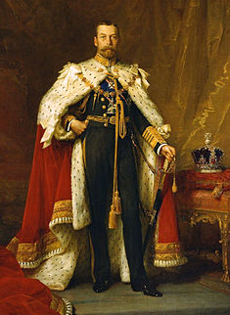
Theseus
His job is a ruler of the kingdom
He a conquestor and to make sure every one follow the rule

Slide 6
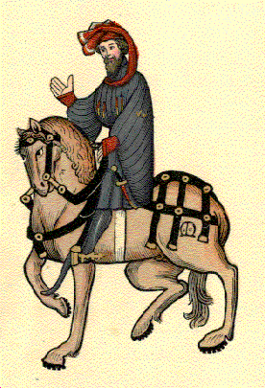
Palamon
Palamon is one of the two imprisoned Theban soldier heroes.
Brave, strong, and sworn to everlasting friendship with his cousin Arcite,
He is in love with Emilye

Slide 7
Palamon and Arcite job in the story
they is the Knight of Thebes.
Job is to sever the kingdom and sever loyalty to the king.

Slide 8
Arcite
The sworn brother to Palamon.
Arcite, imprisoned with Palamon in the tower of Theseus's castle
he Love Emilye

Slide 9
Emilye
Is a beautiful noblewoman
Get captor by Theseus
Her sister is Hippolyta
She like to take care of thing around the castle

Slide 10
Story of the tale

Slide 11
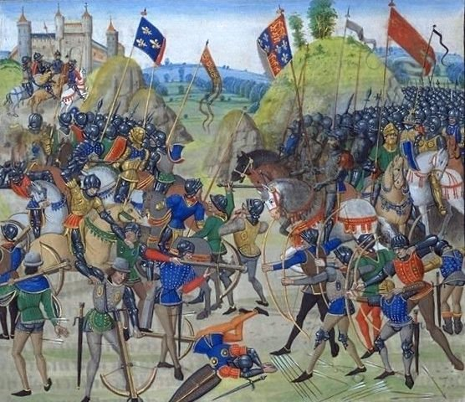
The battle Creon
the war between Athens and Thebes.

Slide 12
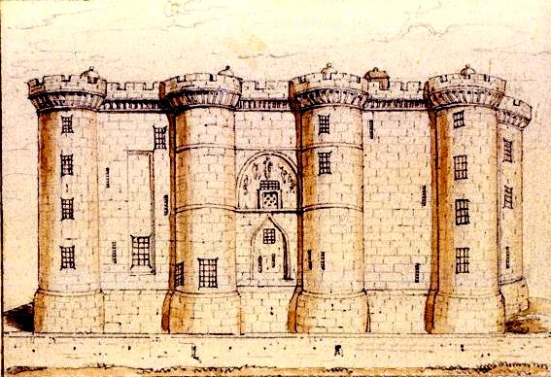
Castle prison
after the war Arcite and Palamon get imprison in side the Castle

Slide 13
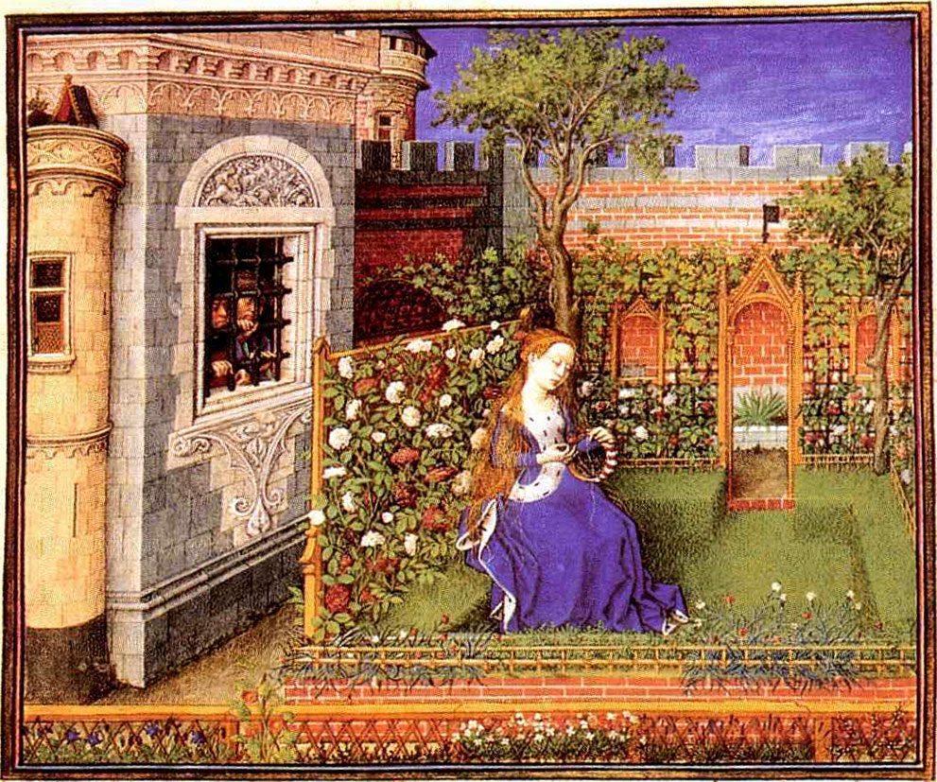
garden in the castle where Palamon and Arcite see Emilye

Slide 14
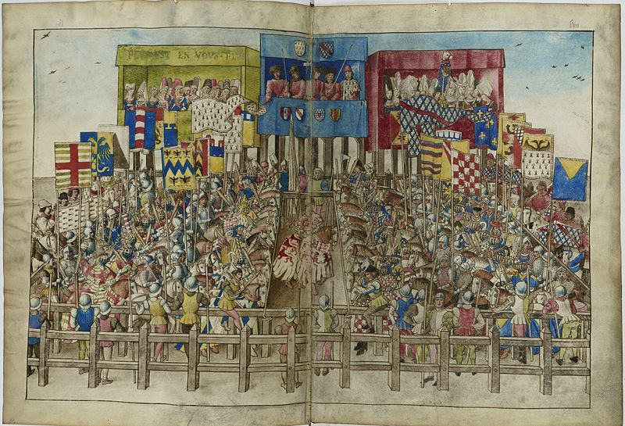
The battle of the knight contest

Slide 15
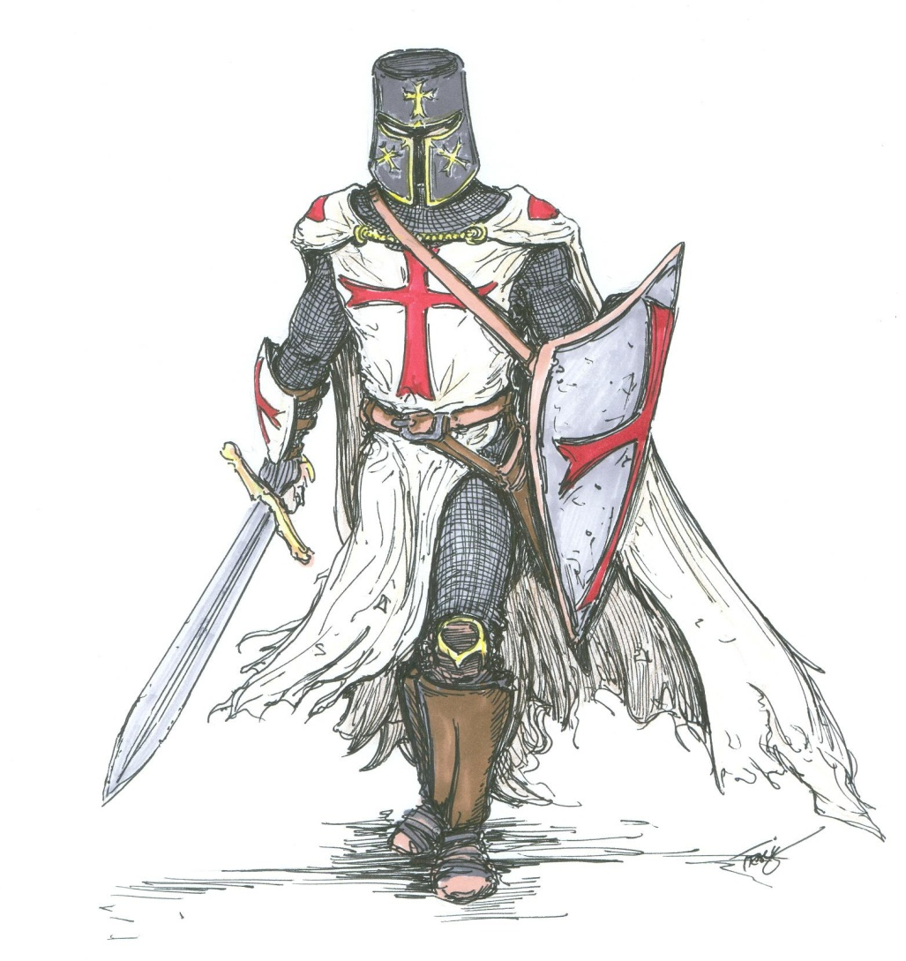
Arcite The last one standing

Slide 16
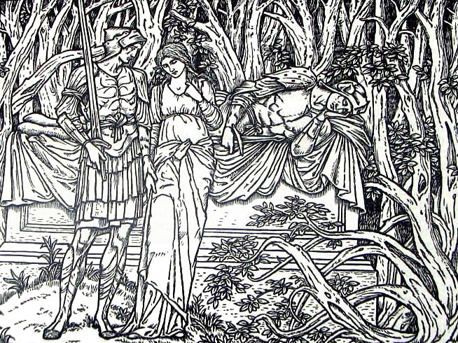
Palamon get Emilye

Slide 17
The moral of the story
The moral of the story is that love can be very powerful even a 2 brother who respect each other of can turn again each when they fall in love with the same woman.

Slide 18
bio
http://www.sparknotes.com/lit/canterbury/characters.html
http://www.shmoop.com/canterbury-tales-prologue/

Slide 19
Summary of the tale

Slide 20
Summary of the tale
Palamon and Arcite is being imprison in the tower Theseus's castle because of the battle Creon, then one day they see Emilye in a nearby garden they bold fall in love whit her from that point they turn again each other and they entry the knight contest and who Is the last one standing is the one Emilye will be marry to.
In the end of the contest Arcite was proclaimed victorious, there was an earthquake sent by Pluto that frightened Arcite's horse, which swerved and fell, throwing off Arcite and mortally wounding before he died, he tell Emilye is that there no more worthy husband than Palamon and from that palamon get Emilye the tale end.

