Slide 1
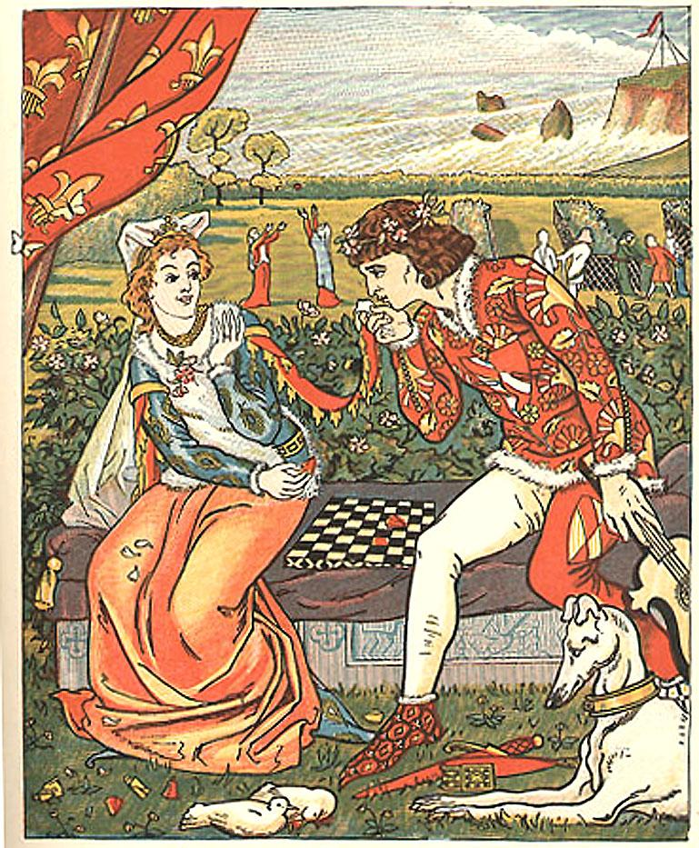
A Franklin’s Tale
A franklin tale is the canterbury tales by geoffrey chaucer it focuses on issues of providence,truth,generosity and gentillesse in human relationships

Slide 2
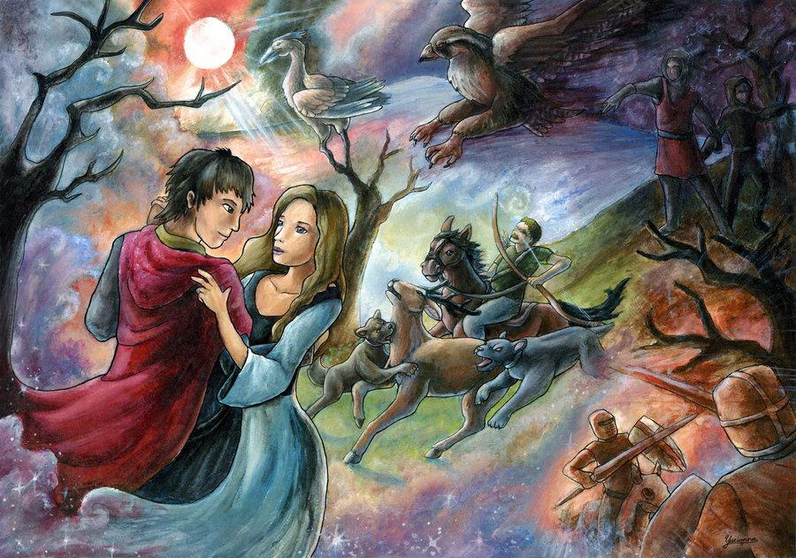
The Franklin’s land owner
*Franklin’s was a medieval land owner and the story is about true love the man(Arveragus and her wife Dorigen. Arveragus fell in love with her and she love him also so they get married.
*Because of issue about equal right on marriage to conceal it Arveragus travel to britain to seek honour and fame, he leave dorigen alone his wife in france near the coastal town, she misses her husband terribly while he is gone.

Slide 3
*Then particularly concerned that his ship will crash while returning home on the black rock of brittany, but while Arveragus was absent dorigen is courted against her will by another suitor a square named Aurelius finally to get rid of him and in a light-hearted mood she make a rash promise and tell Aurelius that he might have her love providing he can dispose of all the rocks coast of brittany so her husband might safe so Aurelius finally manages to secure Aurelius get help of a magician scholar through his magic to vanish the rocks.

Slide 4
*When the rocks vanish Aurelius comforts dorigen and demand that she fulfill her bargain she and her husband agonise over her predicament for by this time Arveragus has returned safely
*Then Aurelius who love dorigen wife of Arveragus have realized about their true love that even they got separated from each other for some reason but still they love each other and Arveragus safely returned back out of that brittany black stone with the help of magician and Aurelius.

Slide 5
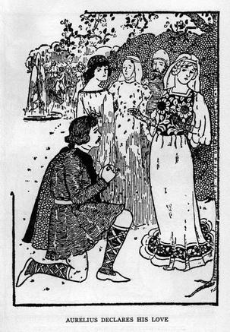
*Aurelius who like Arveragus wife have recognise their true love that the couple’s love is true and he let them be together not to interfere between them.
*So the story is about trust generosity and honour in true love.

