Slide 1
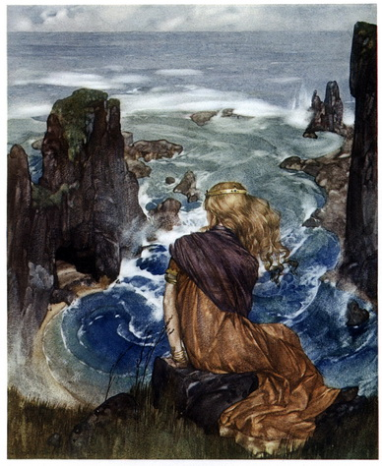
The Canterbury Tales : The Franklin's tale Aline Abdo Period : 1

Slide 2
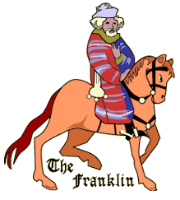
The franklin’s tale The Franklin
A medieval landowner and a prosperous a country gentleman, but non-noble
He was hopeful and confident about future.
He lived for pleasure.

Slide 3
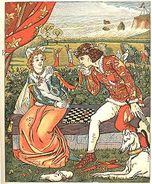
The Franklin’s tale
Averages marries the beautiful Dorigen.
Their marriage was based on equality.
they agree that, in public, Averages should make decisions so as not to draw suspicion.

Slide 4
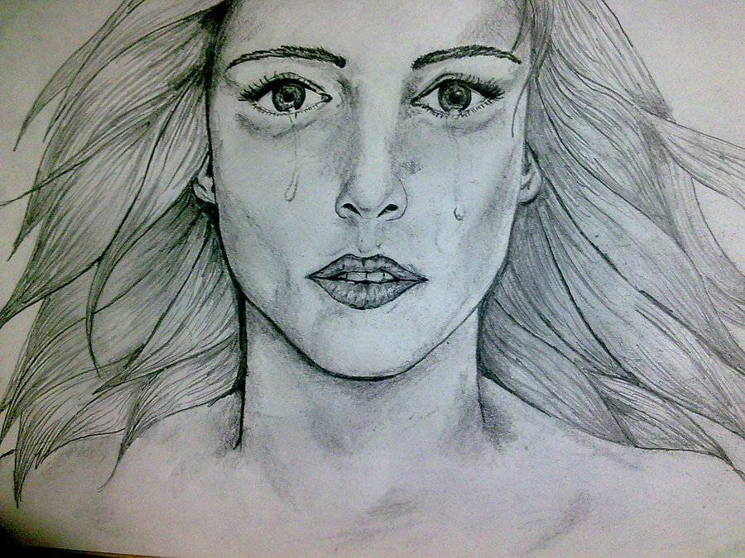
The Franklin’s tale
The couple were happily married then Averages goes to Britain for work.
She becomes very sad.
Everybody tried to make her happy.

Slide 5
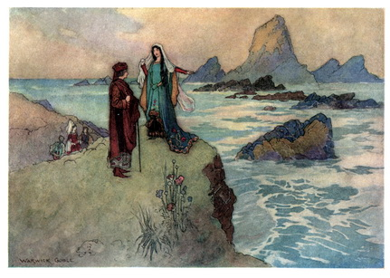
The Franklin’s tale
Dorigen’s friends take her to garden party.
Aurelius confess love to her, he had been in love with her almost two years.
She rejected him.
Dorigen said she will only love him if he removes all the rocks from the coast.

Slide 6
The Franklin’s tale
Aurlius’s brother tells his him to go to a law student who knows magic.
The law student said he will help for 100 pounds.
Dorigen was in a difficult situation and really mad .

Slide 7
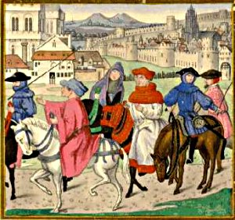
Th Franklin’s tale
Averages is shocked and angry. He tells his wife to do what she promised to do.
Aurelius said he will not make her keep her promise because of his love for Dorigen.
He goes to the law student and tells him he can’t pay him for making the rocks go, the law student sad he doesn’t have to pay.

Slide 8
The Franklin’s tale

Slide 9
Reference
http://en.wikipedia.org/wiki/The_Franklin%27s_Tale
http://www.cliffsnotes.com/literature/c/the-canterbury-tales/summary-and-analysis/the-franklins-prologue-and-tale
https://machias.edu/faculty/necastro/chaucer/translation/ct/13frant.html

