Slide 1
The Black Death
.

Slide 2
The Black Death was one of the most devastating pandemics in human history.

Slide 3
The pathogen responsible is the Yersinia pestis bacterium.

Slide 4
Thought to have started in China, it travelled along the Silk Road and reached the Crimea by 1346.
It was carried by Oriental rat fleas living on the black rats that were regular passengers on merchant ships. It spread throughout the Mediterranean and Europe.

Slide 5
Oriental rat flea
Thought to have started in China, it travelled along the Silk Road and reached the Crimea by 1346.
. The Black Death is estimated to have killed 30–60 percent of Europe's population, reducing world population from an estimated 450 million to between 350 and 375 million in the 14th century. It took 150 years for Europe's population to recover. The plague returned at various times, killing more people, until it left Europe in the 19th century.

Slide 6
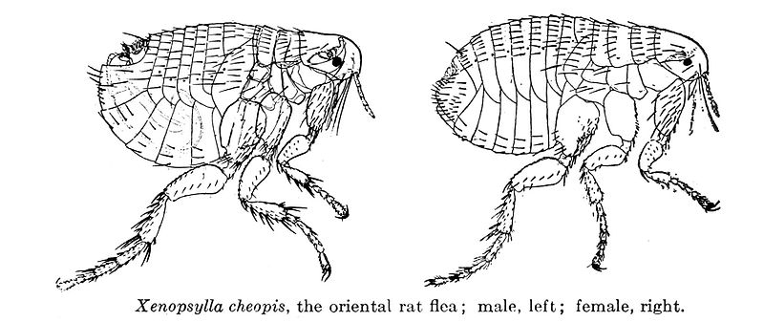
Symptoms:
Contemporary accounts of the plague are often varied or imprecise. The most commonly noted symptom was the appearance of buboes (or gavocciolos) in the groin, the neck and armpits, which oozed pus and bled when opened.

Slide 7
"In men and women alike it first betrayed itself by the emergence of certain tumours in the groin or armpits, some of which grew as large as a common apple, others as an egg...From the two said parts of the body this deadly gavocciolo soon began to propagate and spread itself in all directions indifferently; after which the form of the malady began to change, black spots or livid making their appearance in many cases on the arm or the thigh or elsewhere, now few and large, now minute and numerous.

Slide 8
"It is said that the plague takes three forms. In the first people suffer an infection of the lungs, which leads to breathing difficulties. Whoever has this corruption or contamination to any extent cannot escape but will die within two days. Another form...in which boils erupt under the armpits,...a third form in which people of both sexes are attacked in the groin."

Slide 9
The first assumption of cause of the sickness:
Most thought the real reason behind the plague was that it was God's punishment for people's sins -- and some sought to appease God by building churches and practicing penance such as flagellation. Others tried to find scapegoats, such as Jews. There were many attacks against Jewish communities.

Slide 10
When an infection with the bacteria that causes plague (Yersinia pestis) is suspected, the person is typically hospitalized and placed in isolation.
Antibiotics as Treatments for Bubonic Plague
Specific antibiotics:
Streptomycin
Gentamycin

Slide 11
Video for bubonic plague: - http://www.youtube.com/watch?v=rZy6XilXDZQ -http://www.guardian.co.uk/science/video/2011/oct/12/decoding-black-death-video -http://www.history.com/videos/the-black-death-begins#the-black-death-begins

Slide 12
Source: http://en.wikipedia.org/wiki/Black_Death

