Slide 1
Plague disease

Slide 2
Plague is a deadly infectious disease that is caused by the enterobacteria Yersinia pestis, named after the French-Swiss bacteriologist Alexandre Yersin.

Slide 3
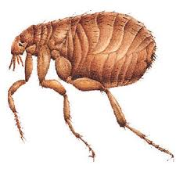
Transmission of plague
Plague is normally transmitted to humans by the bite of a flea that has ingested blood from an infected rodent, such as a rat, squirrel, or prairie dog. Transmission from person to person usually occurs only if a person's lungs become infected, in which case the disease is highly contagious and can be transmitted to others easily through a cough or sneeze.

Slide 4
Rat
squirrel

Slide 5
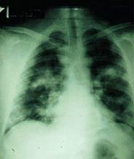
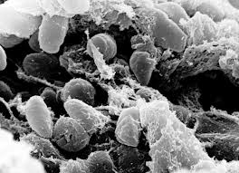
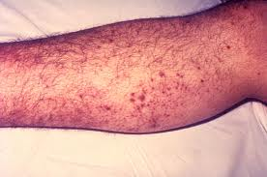
In human
Forms of plague
Bubonic plague
septicemia plague
pneumonic plague

Slide 6
Bubonic plague
1
Bubonic plague usually results from a flea bite and is characterized by swollen lymph glands called buboes that are extremely painful and that give this form its name. Other symptoms include fever, muscle aches, and weakness. Hemorrhaging (heavy bleeding) under the skin can result in patches of dead tissue that appear black. (Hence, this disease is sometimes referred to as the Black Death.) If not treated, bubonic plague has a death rate of about 60 percent, meaning three out of every five people who contract it will die.

Slide 7
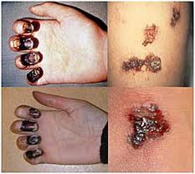
Septicemia plague
2
In another form of plague, called septicemia plague, bacteria enter the blood and cause infection throughout the body. This is a rapidly fatal form that usually results in death within two days if not immediately treated.

Slide 8
Pneumonic plague A third form, called pneumonic plague, occurs when the bacteria infect the lungs. Pneumonic plague results in pneumonia and is highly contagious. It also usually causes death within two or three days of the initial infection if left untreated.
3

Slide 9
Plague pandemics
The most famous bubonic plague pandemic occurred in the fourteenth century in Europe and parts of Asia. Called the Black Death, this pandemic was caused by infected rats carried to Europe in trading ships. It killed about one-third of Europe's population. Because it caused so many deaths, this particular outbreak of plague had a major impact on the economy and political structure of Europe.

Slide 10
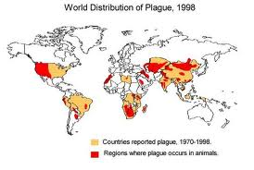
Plague pandemics
A plague pandemic that began in Burma in 1894 spread to China through Hong Kong, and then to North and South America. During this pandemic, the United States saw its first outbreak of plague, occurring in San Francisco in 1900. In 1994, an outbreak of plague in India killed 56 people and caused widespread panic.

Slide 11
Prevention
Plague pandemics can be prevented by disinfecting ships, aircraft, and persons who are known to be infected with the disease. The classic route of transmission that leads to pandemics is the transportation of infected rodents aboard transcontinental vehicles. Since many countries have rigorous procedures for disinfection of ships and planes, plague cases have dropped dramatically. Control of rodent populations in cities is an additional means of preventing plague outbreaks.

Slide 12
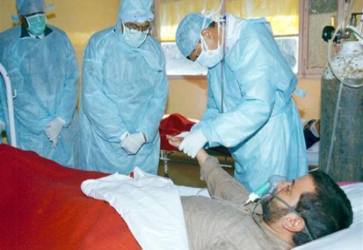
If a person is diagnosed with plague, most countries, including the United States, require that the government health agency be notified. The person is usually kept under strict quarantine (in isolation) until the disease is brought under control with antibiotics.

Slide 13
Video

Slide 14
References:
1. Google.com
2. Mather high school research
3. Mather high school images
4. youtube

Slide 15
Done by: Amal yaghmour

