Slide 1
Diseases of Plague
This diseases call plague is humans and mice usually infected by fleas.
It spread throughout of the west United State and many countries. North America from China in the late 1800's.It can be seen that plague is now present in animals throughout the western United States, as well as in southwestern Canada. Other major regions where animals carry plague are southern Africa and central Asia.

Slide 2
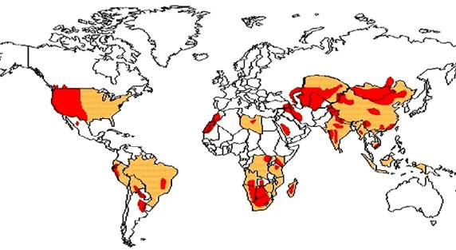
This is the map that where is the Plague spread

Slide 3
How this diseases spread to humans?
Mice and mouse are both carry diseases and spread to humans by contact with mouse dropping through consumption of contaminated food. Also if the mice or mouse bite your body, you will get suggests to live. Rats and mice are both carriers of this potentially fatal disease.

Slide 4
Ways that rats transmit disease to humans:
By biting;
By infecting human food with droppings;
By infecting human food with urine;
By infecting skin wounds with urine;
Indirectly, by blood-sucking insects;
Indirectly, by mites;
Indirectly, by means of cats and dogs;
By dying in a water source drunk by humans

Slide 5
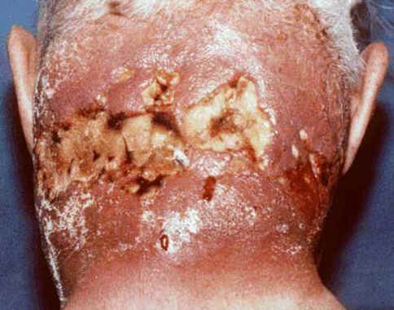
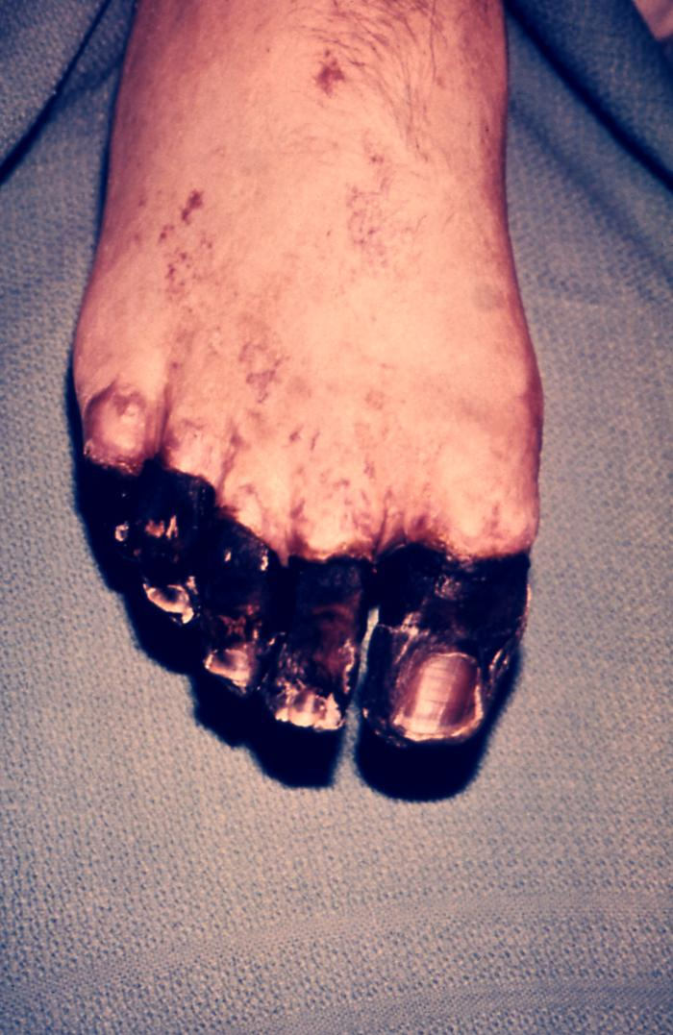
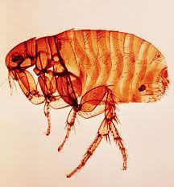
This is the picture of the plague Diseases

Slide 6
This is the Symptoms
Plague is divided into three main types bubonic, septicemia and pneumonic but depending on which part of your body is involved.
Bubonic plague Bubonic plague is the most common variety of the disease.

Slide 7
This is the how many people die by diseases
25 million people died in five years between 1347and 1352.
1. In 1000 38 million people died.
2. In 1100 48 million people died.
3. In 1200 59 million people died.
4. In 1300 70 million people died.
5. In 1347 75 million people died.
6. In 1352 50 million people died.

Slide 8
For more information please click this links….
http://www.mayoclinic.com/health/plague/DS00493/DSECTION=symptoms
1.http://www.macroevolution.net/diseases-carried-by-rats.html
2.http://www.macroevolution.net/bubonic-plague.html#.T3uU8jEgfyB
3.http://www.themiddleages.net/plague.html
4.http://www.google.com/search?tbm=isch&hl=en&source=hp&biw=1777&bih=852&q=plague&gbv=2&oq=plague&aq=f&aqi=g10&aql=&gs_l=img.3..0l10.5569l10196l0l10826l6l6l0l1l1l0l337l958l0j4j0j1l5l0.llsin.
Thank you

