Slide 1
Swine Flu
By Ninorta Dammo

Slide 2
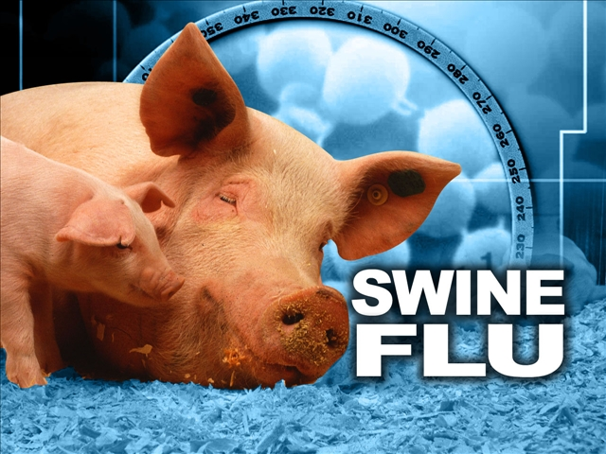
Swine flu begins in pigs.
It is also called H1N1.

Slide 3
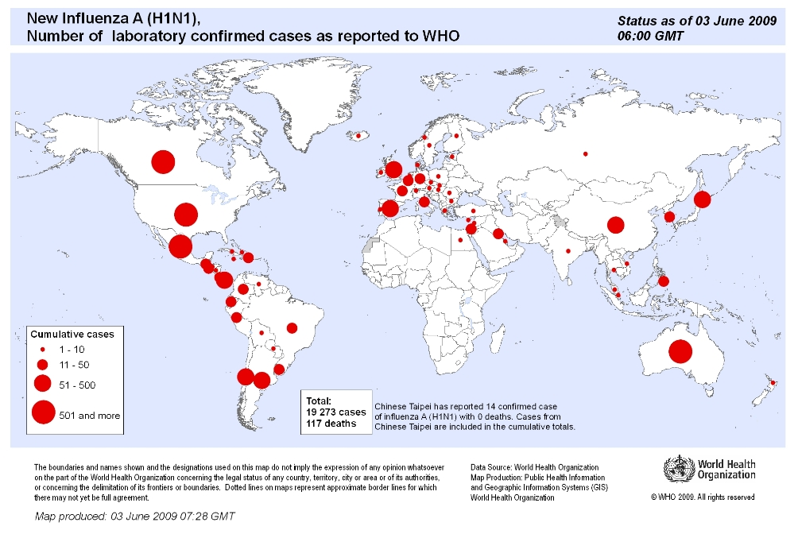
Where?
The swine flu started around 1918 in North America and came back 1976

Slide 4
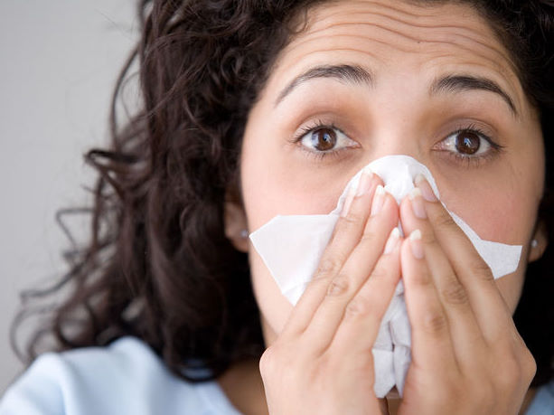
Sings and Symptoms
Fever
Cough
Sore throat
Runny nose
Body aches
Headache
Chills
Tiredness

Slide 5
More about the Symptoms
Symptoms are flu-like.
Recovery.
After recovery.

Slide 6
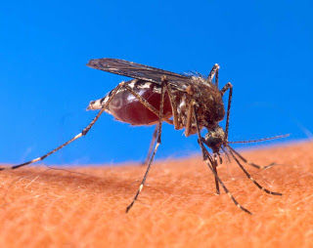
Vector-Borne
Vector-borne describes a disease that is carried by a small animal from person to person

Slide 7
How does swine flu transfer?
Swine flu is passed by humans touching, coughing, and sneezing
It’s not usually passed from pigs to humans but it can be through touching

Slide 8
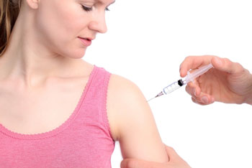
There is a vaccine for H1N1
Medicine Is usually antiviral drugs

Slide 9
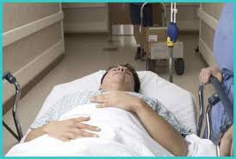
How Many people die each year?
In the 2009 outbreak, the CDC said that up to 400,000 died
Now, information on deaths from the flu is very limited

Slide 10
http://www.youtube.com/watch?v=lFl3FRNpU4E

Slide 11
Bibliography
http://www.webmd.com/cold-and-flu/features/swine-flu-faq-1?page=2
http://www.cdc.gov/h1n1flu/diagnosis/

