Slide 1
Malaria disease
Rathahao, Vilavone

Slide 2
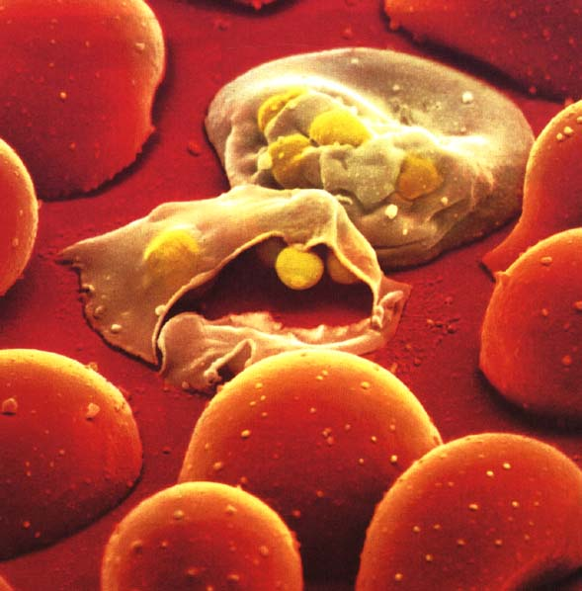
Malaria fever
Malaria is an infectious blood disease caused by a parasite that is transmitted from one human to another by the bite of infected Anopheles mosquitoes. Malaria symptoms, which often appear about 9 to 14 days after the infectious mosquito bite, include fever, headache, vomiting and other flu-like symptoms.

Slide 3
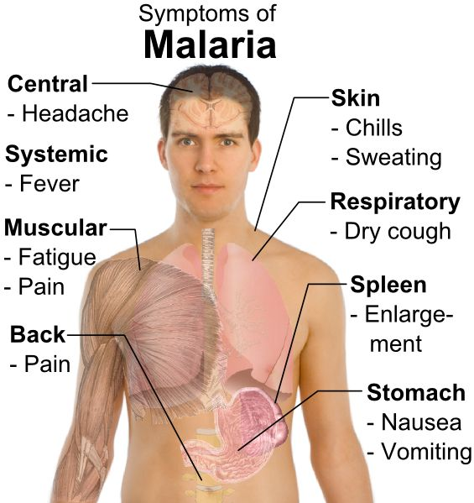
It used to happened with my young brother
When my young brother was child he almost die cause of this fever by that time I was 10-11 years old I did remember he was sleep in ICU room at hospital in my native country I could remember when he was sick and he need bloods and salt water so he need a lot of blood … my mom used to be nurse and she knew what happen with my young brother she took her blood out and shared to my brother .. His symptom was very bad I felt like will lost my young brother then my mom and nurse could save his life … he also get well and well ..

Slide 4
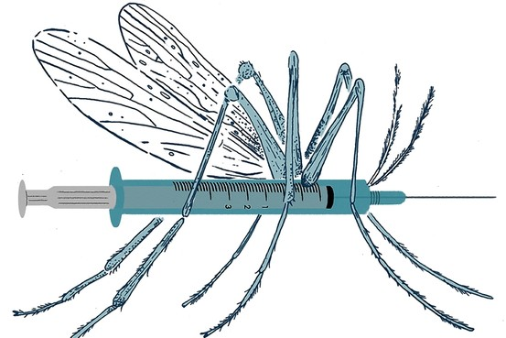
Malaria was carrier by mosquito
How does it carrier???
Malaria is caused by Plasmodium parasites that are spread to people through mosquito bites.

Slide 5
Mosquito carrier malaria disease

Slide 6
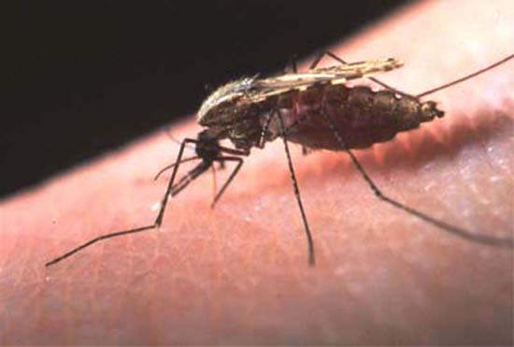
The mosquito did bite to transfer malaria disease in to our body

Slide 7
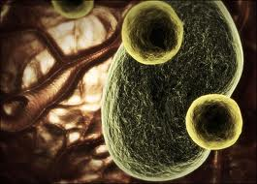
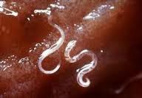
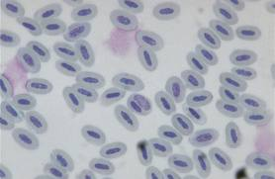
by a parasite that is transmitted from one human to another by the mosquito bite

Slide 8
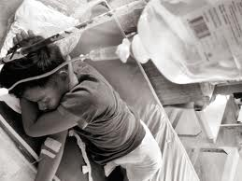
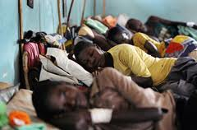
Illness & injury
If drugs are not available or the parasites are resistant to them, the infection can lead to coma and death.
You could be easy to get death by Malaria disease if you do not know or don’t go to hospital at the time…

Slide 9
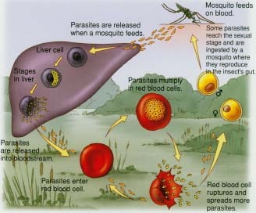
I think if you used to get malaria disease and malaria was gone then you were not had malaria disease along time …. It could be come back to your self again if you’re not protect your self well an I was think malaria disease was stuck in your body all the time but it does n’t become fever or make you were sick who will know ???

Slide 10
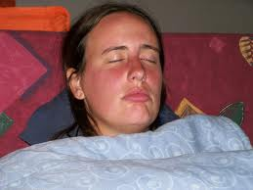
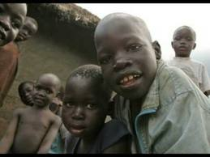
Does malaria effect to adult or child???
Sure it does effected to any age malaria does n’t cared who are you or how old you are it can go all the way to any people
I think child could be easy to death by malaria faster than adult

Slide 11
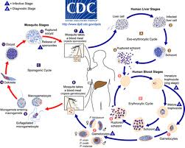
How does malaria spread to human??
Malaria is a preventable and treatable infectious disease transmitted by mosquitoes. It kills more than one million people each year, most of them in sub-Saharan Africa, with seventy-five percent of these deaths occurring in children under five.

Slide 12
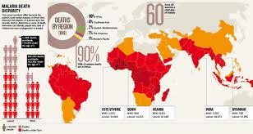
Malaria fact
Malaria is preventable and treatable Every minute, a child dies of malaria
An estimated 655,000 people died of malaria in 2010 The most deadly malaria is plasmodium falciparum
Malaria deaths have fallen by more than 25% since 2000 Malaria is caused by a female mosquito that bites at night
91% of malaria deaths occur in Africa World Malaria Day is April 25th
Malaria costs Africa $12 billion annually In Africa, 40% of health resources are used to treat malaria

Slide 13
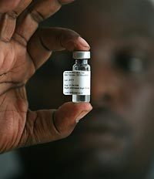
vaccine
the vaccine to the specifically targeted cell type—e.g. the use of Hepatitis B virus in the RTS,S vaccine to target infected hepatocytes—but in other cases, particularly when using combined antigenic vaccines, this approach is very complex. Some methods that have been attempted include the use of two vaccines, one directed at generating a blood response and the other a liver-stage response.

Slide 14
Information from website::
http://en.wikipedia.org/wiki/Malaria_vaccine
http://www.veths.no/en/Home/News/News-stories/Malaria-as-an-complication-to-landmine-and-war-injuries/
http://www.malarianomore.org/malaria?gclid=COikl8WikbQCFYpFMgod1X8AIQ
http://www.mmv.org/malaria-medicines/definitions-and-symptoms?gclid=COP1mtGikbQCFYpFMgod1X8AIQ

Slide 15
Video website::
http://www.google.com/url?sa=t&rct=j&q=malaria%20youtube&source=web&cd=6&sqi=2&ved=0CEEQtwIwBQ&url=http%3A%2F%2Fwww.youtube.com%2Fwatch%3Fv%3DCHZNm7CpM7E&ei=65XGUMG9LsHLqQHM6YHIDQ&usg=AFQjCNGyJauSlLND_c0gDyp2hJ8TViNHkg&sig2=vGyE_4p_X7aFybLEjXlkDA

