Slide 1
MALARIA
BY.AIMAN ASKARI 6/510

Slide 2
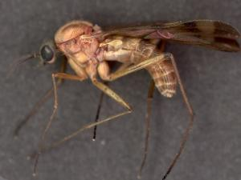
Mosquitoes.
Symptoms of malaria include periodic chills, fever, headache ,and sweating, and sweating ,kidney problems, liver , damage ,brain, problems, problems.

Slide 3
BLOOD CELL.
s

Slide 4
QUININE.
Quinine is a treatment for malarial fevers
the curative power of the cinchona bark was discovered around 1640 in South America, where the cinchona tree grows. Quinine is a white crystalline alkaloid.
It acts by interfering with the growth and reproduction of the malarial parasites in the red cells of the blood.

Slide 5
PRIMAQUINE.
Primaquine also inhibits the development of the parasites in the liver, thus preventing relapses.

Slide 6
Spraying.

Slide 7
Map.

Slide 8
Malaria Bar Graph.

Slide 9
Thermometer.
A Stage With a High Temperature to 105 ` F (41’C) and stage with sweating that brings down the temperature.
The incubation period is usually one to two weeks but weeks but can be as long as 10 manths if the.

Slide 10
School.eb.com/print ? told=9275631
Full Article =true & tocid =92756
School.eb.com /comptons/art-155973.

