Slide 1
Malaria

Slide 2
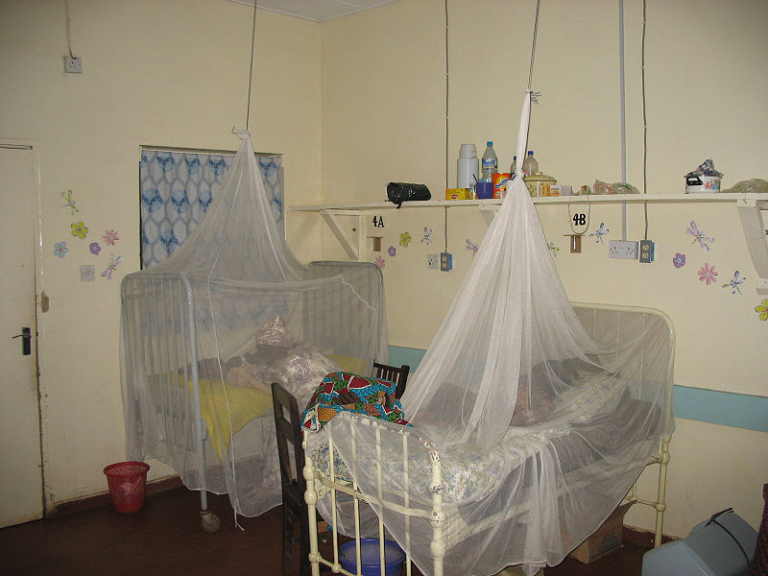
Save from malaria
Mosquito nets create a protective barrier against malaria-carrying mosquitoes that bite at night.

Slide 3
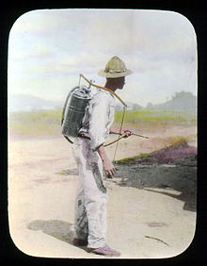
Man spraying kerosene oil in standing water,
Vector control refers to preventative methods used to decrease malaria and morbidity and mortality by reducing the levels of transmission.

Slide 4
Malaria transmitted
Malaria is an infectious disease caused by a parasite, Plasmodium, which infects red blood cells. Malaria is characterized by cycles of chills, fever, pain, and sweating. Historical records suggest malaria has infected humans since the beginning of mankind.

Slide 5
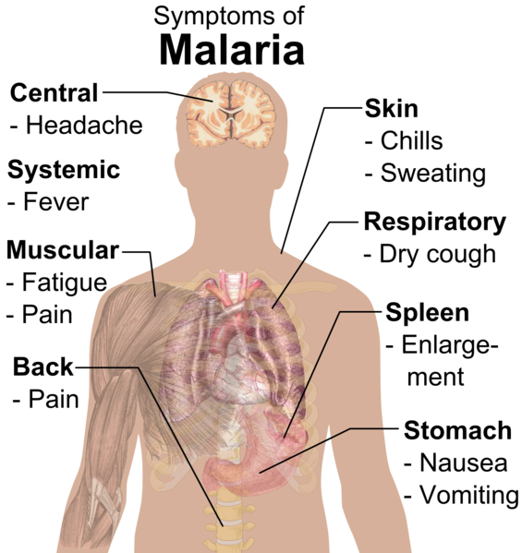
Malaria Symptoms
Symptoms of malaria include fever and flu-like illness, including shaking chills, headache, muscle aches, and tiredness. Nausea, vomiting, and diarrhea may also occur.

Slide 6
Website link
Http://www.malaria.com/
http://www.passporthealthusa.com/vaccinations/malaria-information/

Slide 7
Does malaria spread
Malaria is not spread from person to person like a cold or the flu, and it cannot be sexually transmitted

Slide 8
Protective Measures Against Malaria
Remaining in well-screened or air conditioned areas
Using mosquito nets treated with Permethrin
Wearing clothing that covers most of the body and has been treated with Permethrin
Using insect repellents containing appropriate levels of DEET
Using insecticides in living and sleeping areas where appropriate

Slide 9
. Today is malaria in world

Slide 10
People lost by this disease each year
Each year, between 655,000 and 1.2 million people died from the disease ..... capital costs required are out of reach of many of the world's poorest people.

Slide 11
malaria medication

