Slide 1
MACBETH
A Play
By: Zoha, Fatima, Sejal, Sibgha & Ruhi

Slide 2
ACT i
there was a Scottish lord named Macbeth and there was a King named Duncan. One day Macbeth Meets Three Witches who tell him that he will become the King but Macbeth Doesn’t believe them. But then the Witches also said that he will become the Thane of Cawdor which did happen. So he goes to the Witches and asks them:
NCE UPON A TIME,

Slide 3
Will I ever be the King?
Yes Oh Macbeth! You will become the King. But the descendants of Banquo will succeed you.

Slide 4
ACT II
Lady Macbeth then provokes Macbeth to kill Duncan and put the blame on the guards.

Slide 5
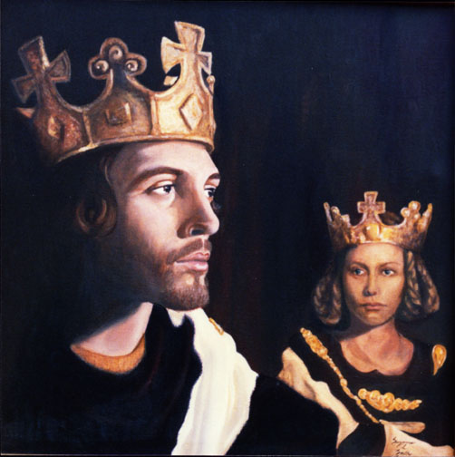
I can’t kill the King! It’s
not right!
But you have to! I would have done it myself but he looks too much like my father.

Slide 6
Okay I’ll do it but we’ll
blame it on the guards.
Fine !
Macbeth then finally gives in and says:

Slide 7
The plan went successfully and Duncan was killed. His two sons, Malcolm and Donalbain flee from the castle when they hear this. Everyone thinks that they were guilty that’s why they fled.
Macbeth becomes the king.

Slide 8
ACT III
Macbeth finds out that Banquo knew he killed the king, so he hires murderers to kill Banquo. Macbeth then goes to the Witches and Asks them about his fear, none that he had right now.

Slide 9
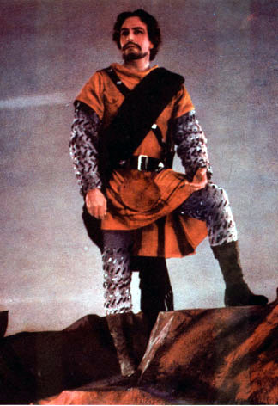
My Witches!
What is it that
I should fear?

Slide 10
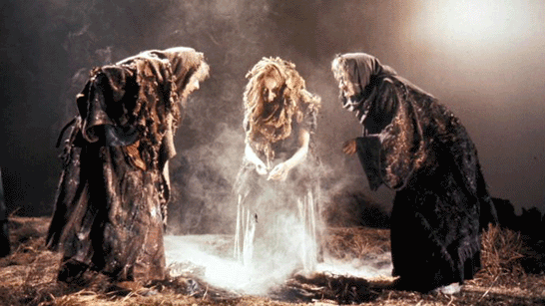
Look out for the Thane of Fife, Macduff.
None born of a woman can kill you.
Do not worry until the forest comes to you.

Slide 11
I have no fear of dying now.

Slide 12
Act iv
Hearing this, Macbeth has Macduff’s family killed. In the fire of revenge, Macduff wanted Macbeth dead. So he goes to his friend in England, Malcolm and they come up with a plan to kill Macbeth.

Slide 13
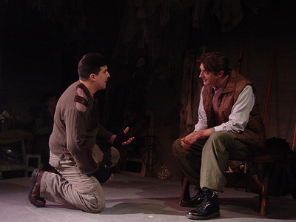
My dear friend, did u hear? Macbeth had my family killed!
I’m sorry. What will you do now?

Slide 14
I seek revenge!
I want to kill Macbeth.

Slide 15
Act v
The scene changes and focuses on Lady Macbeth. Lady Macbeth is filled with guilt. She sees blood on her hands and panics

Slide 16
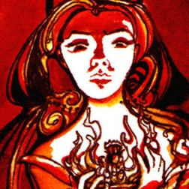
Out you damn spot. Out.!!
aaaahhhh

Slide 17
My King!Your wife killed herself and the branches of the trees in the forest are moving towards the castle.
My men! Get ready for war!

Slide 18
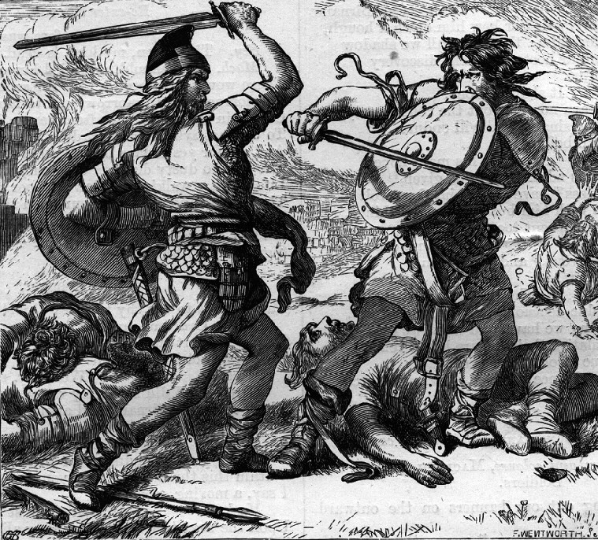
Everyone starts fighting along with Macbeth and Macduff.

Slide 19
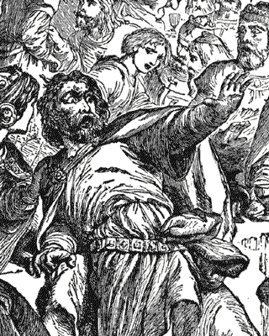
You can’t defeat me. The Witches said that none born of a woman can kill me.

Slide 20
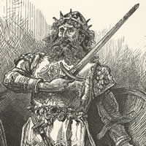
That is exactly where you are wrong Macbeth. I wasn’t born of a woman. I was cut out of my mother’s womb.

Slide 21
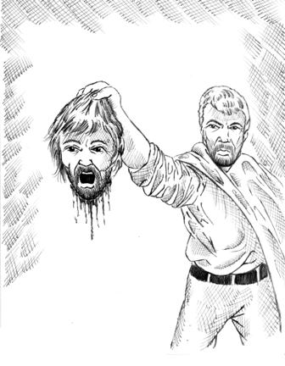

Slide 22
Macbeth gets scared and Macduff wins the fight. He cuts off Macbeth’s head and Malcolm becomes the rightful owner of the Crown he was destined to have.

Slide 23
The End.

