Slide 1
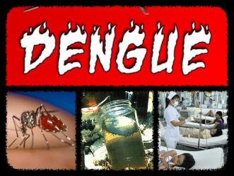
Dengue Fever

Slide 2
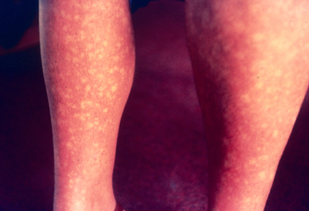
Dengue fever is a disease. It is a type of illness that make you very sick. (Fever) It can kill you if you get it and you don’t go to the doctor.

Slide 3
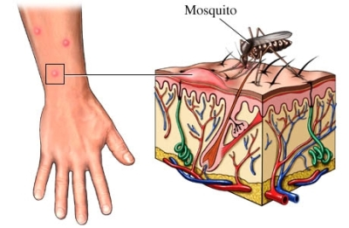
The vector of this illness is the mosquito.

Slide 4
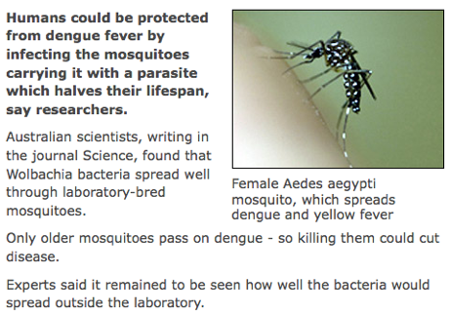
Dengue fever can occur when a mosquito carrying the arbovirus bites a human, passing the virus on to the new host. Once in the body, the virus travels to various glands where it multiplies

Slide 5
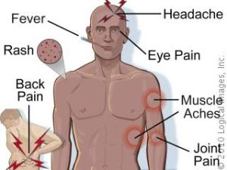
Symptoms of the disease appear suddenly and include high fever, chills, headache, eye pain, red eyes, enlarged lymph nodes, a red flush to the face, lower back pain, extreme weakness, and severe aches in the legs and joints.

Slide 6
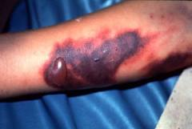
If the patients are further bitten by non-vectors, these non-vectors will become pathogenic, and spread dengue viruses to other people via bites.

Slide 7
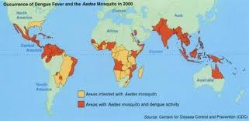
Dengue Fever is spread all over the world.
Instead the part of the world most affected by this decease is Africa.

Slide 8
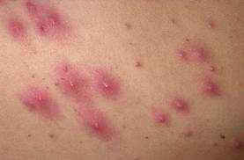
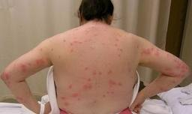
There is no specific drug for Dengue Fever at present, and supportive treatment can only alleviate the patient's discomfort temporarily.

Slide 9
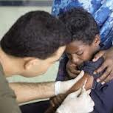
There is no vaccine or medication that protects against dengue fever.

Slide 10
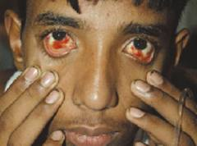
When you get the illness you can die but if you survive to it you have to rest a few days to be better.

Slide 11
http://www.encyclopedia.com/topic/dengue_fever.aspx#1
By: Katia Amador

