Slide 1
Dengue Fever
Guillermo Mata

Slide 2

Dengue fever
also known as break bone fever, is an infectious tropical disease caused by the dengue virus.

Slide 3
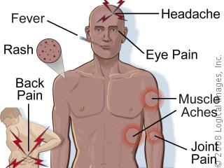
Symptoms
Symptoms include fever, headache, muscle and joint pains, and a characteristic skin rash, that is similar to measles.

Slide 4
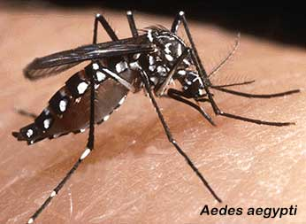
How the virus is transmitted
Dengue virus is primarily transmitted by Aedes mosquitoes, particularly A. aegypti.
They typically bite during the day, particularly in the early morning and in the evening. Other Aedes species that transmit the disease include A. albopictus, A. polynesiensis and A. scutellaris. Humans are the primary host of the virus, but it also circulates in nonhuman primates. An infection can be acquired via a single bite.[ A female mosquito that takes a blood meal from a person infected with dengue fever becomes itself infected with the virus in the cells lining its gut. About 8–10 days later, the virus spreads to other tissues including the mosquito's salivary glands and is subsequently relapsed into its saliva.

Slide 5
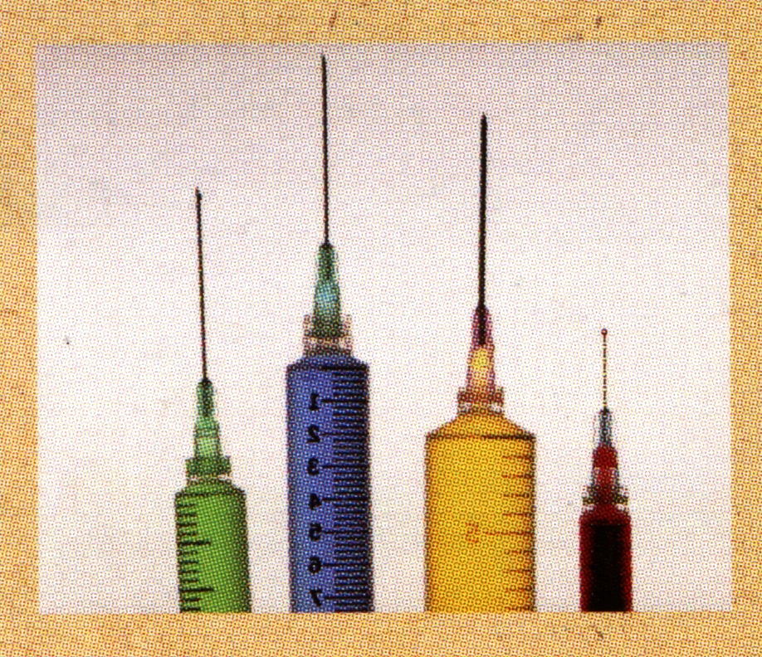
There are currently no vaccines for Dengue fever. The best way to prevent the disease is to avoid being bitten by mosquitoes altogether. Although there is no certain treatment for Dengue, it can be treated as long as it is caught before developing into dengue shock syndrome or dengue hemorrhagic fever

Slide 6
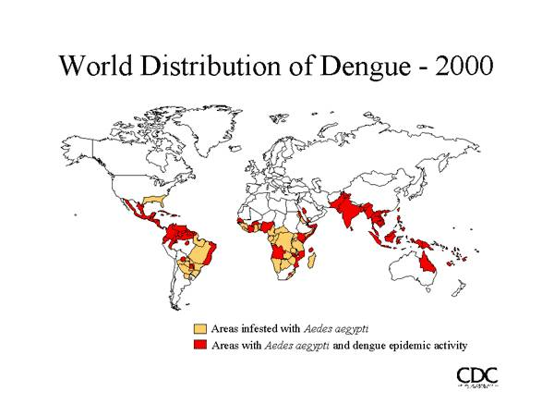
According to the World Health Organization (WHO): Approximately 2.5 billion people, or two-fifths of the world's population, are now at risk from dengue.
The disease is now endemic in over 100 countries.
Dengue hemorrhagic fever is a leading cause of serious illness and death among children in some Asian countries.
In 2007, there were over 890,000 reported cases of dengue in the Americas, of which 26,000 cases were DHF.
Dengue infection rates among people who have not been previously exposed to the virus are commonly 40% to 50% during epidemics, but may sometimes reach 80% to 90%.
Approximately half-a-million people with DHF are hospitalized each year, of whom many are children. About 2.5% of these patients die.

Slide 7
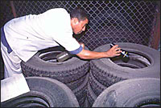
At present, the only method to control or prevent the transmission of dengue virus is to combat vector mosquitoes through:
preventing mosquitoes from accessing egg-laying habitats by environmental management and modification;
disposing of solid waste properly and removing artificial man-made habitats;
covering, emptying and cleaning of domestic water storage containers on a weekly basis;
applying appropriate insecticides to water storage outdoor containers;
using of personal household protection such as window screens, long-sleeved clothes, insecticide treated materials, coils and vaporizers;
improving community participation and mobilsation for sustained vector control;
applying insecticides as space spraying during outbreaks as one of the emergency vector control measures;
active monitoring and surveillance of vectors should be carried out to determine effectiveness of control interventions.

Slide 8
Websites
WWW.WIKIPEDIA.COM
WWW.MEDICALNEWSTODAY.COM
www.who.int
www.google.com

