Slide 1
BUBONIC PLAGUE

Slide 2
What kind of illness it is?
Its name is bubonic plague This form of the disease is highly communicable as the bacteria can be transmitted in droplets emitted when coughing or sneezing

Slide 3
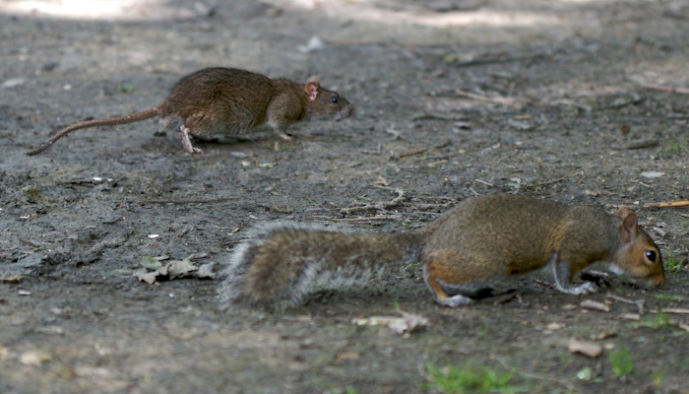
what is the animal that transmits the disease?
the animal that transmits the disease can be all rodents like rats and squirrels

Slide 4
How is it transmited from animals to humans
from the bite of an infected flea. the disease can be transmitted by direct contact with infected tissue or exposure to the cough of another.

Slide 5
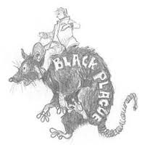
The fleas are often found on rodents such as rats and mice

Slide 6
Signs and symptoms
Bubonic plague symptoms appear suddenly, usually after 2 - 5 days of exposure to the bacteria. Symptoms include:
Chills
Fever
General ill feeling (malaise)
Headache
Muscle pain
Seizures
Smooth, painful lymph gland swelling called a bubo
Commonly found in the groin, but may occur in the armpits or neck, most often at the site of the infection (bite or scratch)
Pain may occur in the area before the swelling appears

Slide 7
Treatment
Several classes of antibiotics are effective treating bubonic pleague.
These include aminoglycosides such as streptomycin and gentamicin, tetracyclines (especially doxycycline), and the fluoroquinolone ciprofloxacin.

Slide 8
Does it affcet children,adult or both?
The basic effects of bubonic plague are the same whether a person is a child or an adult. However, one study has indicated that children are more likely to have swelling in the cervical and armpit areas. During the period of history known as the Black Death epidemic, when the bubonic plague killed about one-third of European people, the mortality rate of children was exceptionally high. Recent research suggests that this trend continues today; in one study found that three-fourths of the people in the study who were infected with the plague were less than 25 years old.

Slide 9
HOW DOES IT SPREAD BUBONIC PLAGUE FROM HUMAN TO HUMAN?
The bacteria that cause plague (Yersinia pestis) are found throughout certain parts of the world, most commonly in rats, but occasionally in other wild animals, such as prairie dogs. Transmission of bubonic plague from these infected animals generally occurs in one of three ways:
Inhaling infected droplets
Direct contact with infected tissue or bodily fluids
Bites from infected fleas.

Slide 10
where was it first discovered bubonic plague?
The results indicate that plague appeared in China more than 2,600 years ago, it then spread towards Western Europe then to africa
Plague came to the United States from China via Hawaii in the late 19th century, according to the molecular evidence.It arrived in California through the ports of San Francisco and Los Angeles before heading inland.

Slide 11
Does it still occur in the world?
According to the World Health Organization, there are 1,000 to 3,000 cases of bubonic plague worldwide each year. There are no known cases in Australia or Europe. Areas where cases occur are in Russia, the Middle East, China, Southwest and Southeast Asia, Madagascar, southern and eastern Africa, the Andes mountains and Brazil.
The U.S. Centers for Disease Control and Prevention (CDC) reports that there are 10 to 15 cases of bubonic plague in the United States each year. These cases tend to occur in two regions: northern New Mexico, northern Arizona and southern Colorado; California, southern Oregon and far western Nevada.

Slide 12
HOW MANY PEOPLE DIED BY BUBONIC PLAGUE?
There were 75 million people that were killed by the Black Death, also known as the Bubonic Plague. The Black Death was in reference to one of three related diseases, one of which was the Bubonic Plague. There is no real evidence of the total body count. They are educated guesses, only that, conjecture. Though rough estimates, they are probably still close enough to inform people.

Slide 13
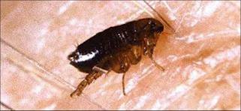
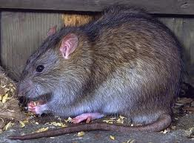
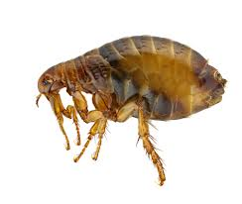
SOME PICTURES OF RATS AND FLEAS.

Slide 14
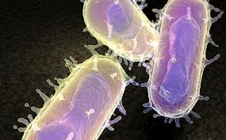
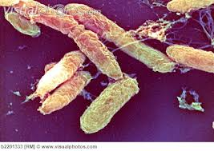
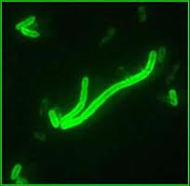
BACTERIAS

Slide 15
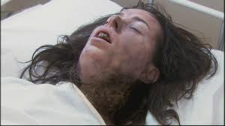
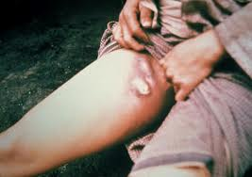
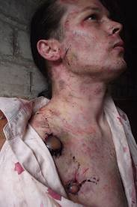
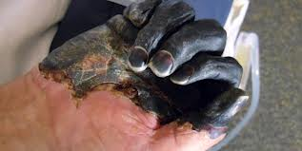
PUCTURES OF PEOPLE SICK

Slide 16
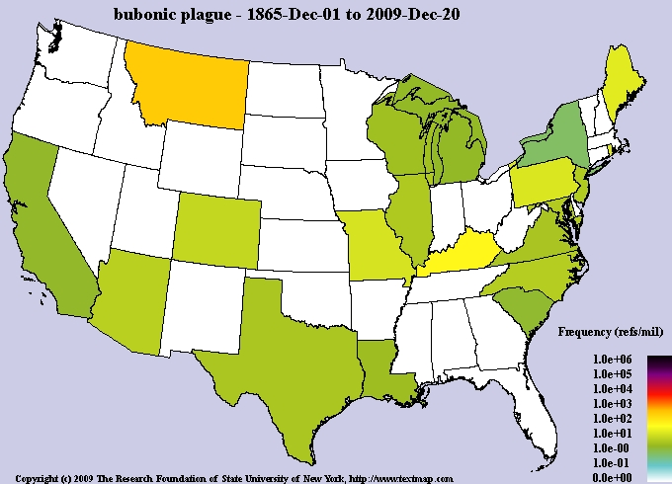
MAP IN U.S

Slide 18
Where you can find this information?
http://en.wikipedia.org/wiki/Bubonic_plague
www.google.com

