Slide 1
Disease : Black death
By : Yu Feng liu
12/08/2012
Pre:3/HR:621

Slide 2
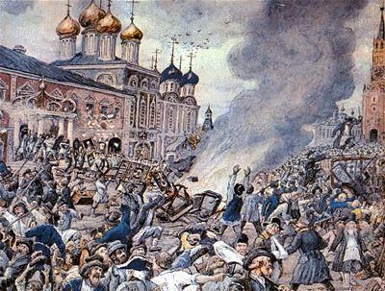
What is black death
Black death is Yersinia pestis caused by natural foci of disease.

Slide 3
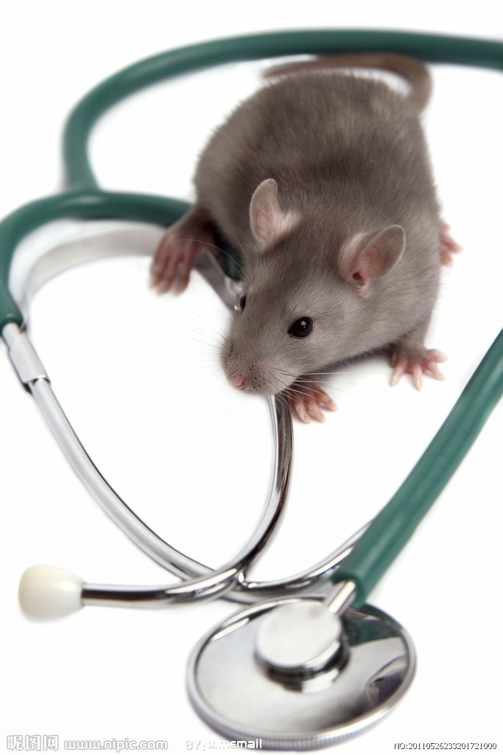
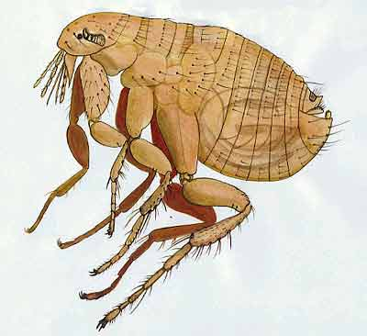
What causes the Black Death
Mouse will causes the black death.
Mouse is important Source of Infection.
Mouse have flea, the mouse flea will make you get sick and fever.

Slide 4
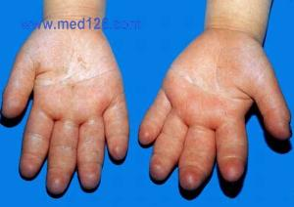
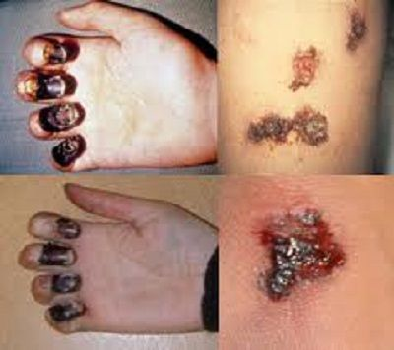
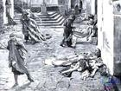
What is the illness of the Black Death
If you got black death , then you will got fever , Pneumonia , Severe sepsis, Edema and hemorrhage .
If you have these illness , then you didn’t went to Hospital, you will From 24 hours to 8 days of death.

Slide 5
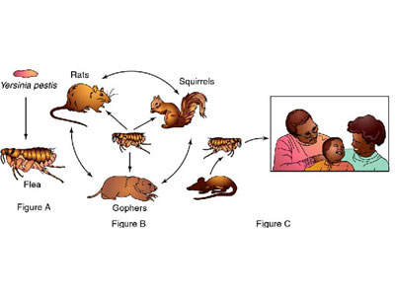
Propagation
The mouse → fleas → mode of transmission.
If you got black death, and you didn’t die , you can not got sick again.

Slide 6
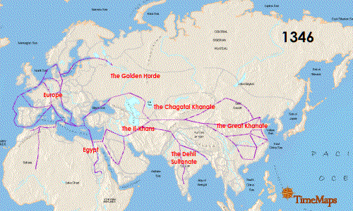
Die
From 1348 to 1352, black death kill One-third of Europe's population, A total of about 25 million people! In 1467, 127,000 people died in Russia.(please Press F5 saw this picture)

Slide 7
Scientist
Scientist think The black death may be only temporary dormancy, could explode again.
Event today still happening.

Slide 8
Video
http://www.youtube.com/watch?v=BsCkgX2epFw
http://www.youtube.com/watch?v=Gs5Uh0Fah_k

Slide 9
information from
Http://baike.baidu.com/view/70725.htm
http://zh.wikipedia.org/wiki/黑死病

