Slide 1
The black death:
By: Sadiya Fatima.

Slide 2
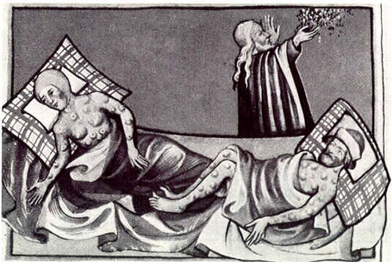
The black death:
The black death is a type of flu that spreads. People get high fever and then they die in 1 or 2 weak, they also get blood vomiting.

Slide 3
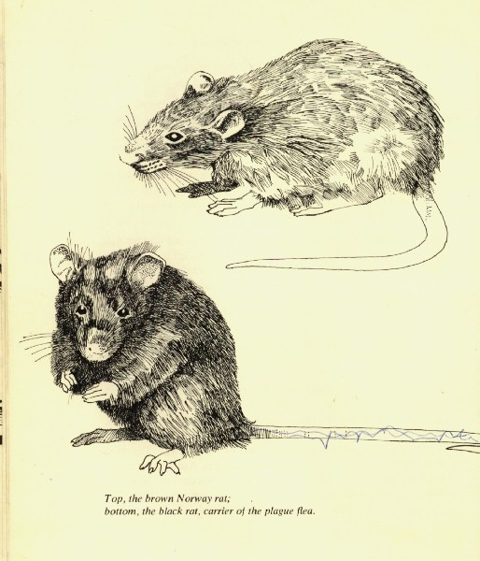
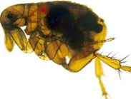
vector born is a flea that a black rat carries all the time. This flea jumps on people and bite them.

Slide 4
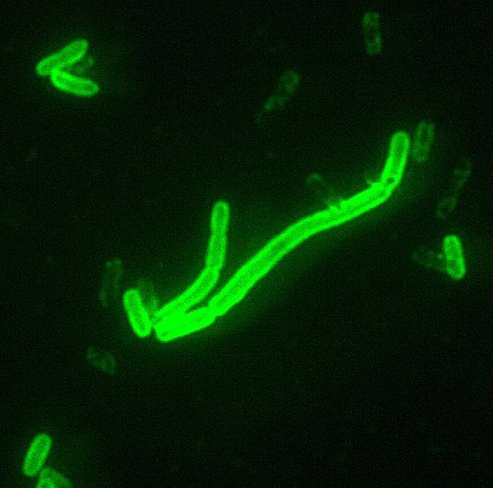
Symptoms:
A bite of a rat’s flea means death. It’s the bacteria that causes bubonic plague. Bubonic plague is the deadly bacteria.

Slide 5
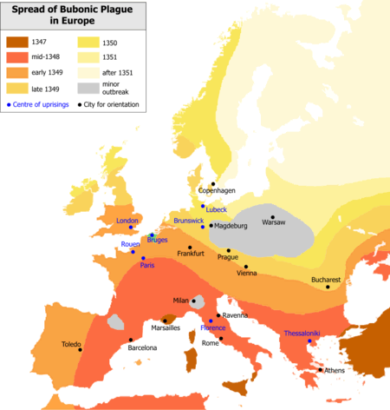
Europeans death.
Half of the Europe's population was affected from bubonic plague.

Slide 6
spread.
The disease spreads from human to human when a person with bacteria cough or sneeze.

Slide 7
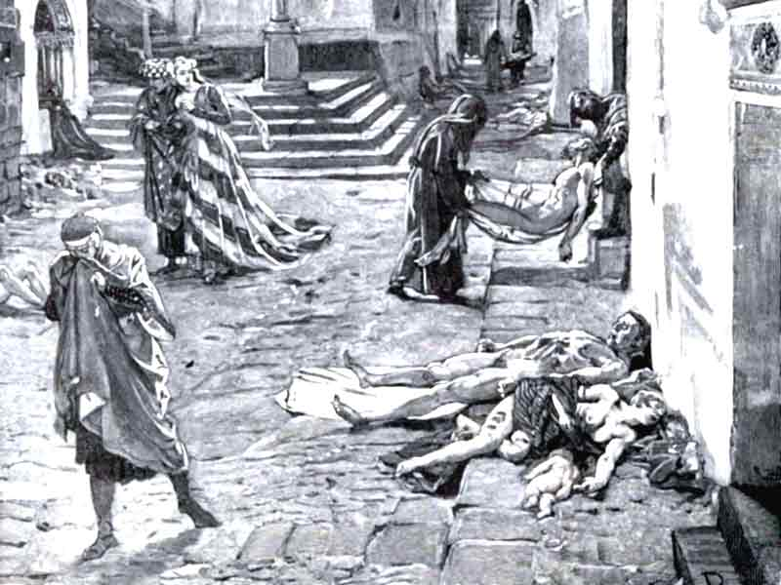
People died.
The black death killed 1.5 million people out of 4 million people between 1348 and 1350.

Slide 8
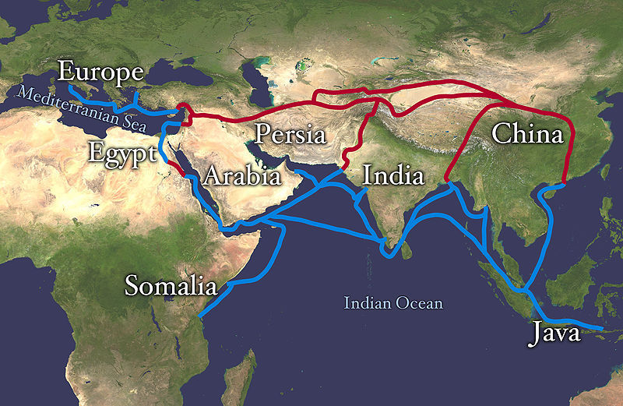
Spreading
The black death spread by the silk road of china or the ships.

Slide 9
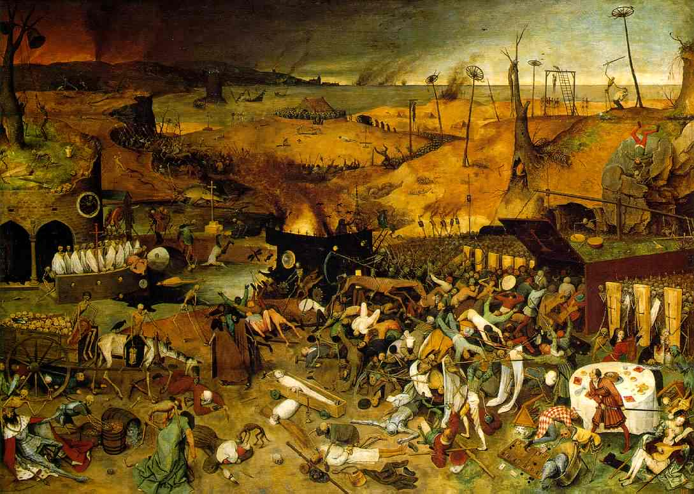
Death each day:
In most cities around 800 people died each day.

Slide 10
List of websites:
www.en.wekipedia.org
www.google.com
www.youtube.com

Slide 11
Video:

