Slide 1
Black Death
By : Isaac Okyere

Slide 2
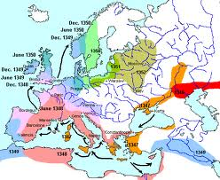
Black Death originated in Central Asia and then spread to Europe

Slide 3
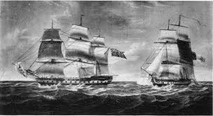
The Disease started in China and some merchants took some fleas with them on the ship that was going to Sicily (Italy).

Slide 4
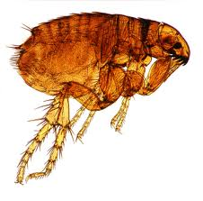
The Disease come from a small Rat Flea. The Flea then bites a person and keep feeding of its victim.

Slide 5
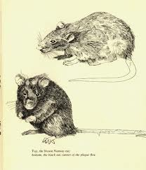
The Disease was also carried by rats and back the rats sneaked their way into ships

Slide 6
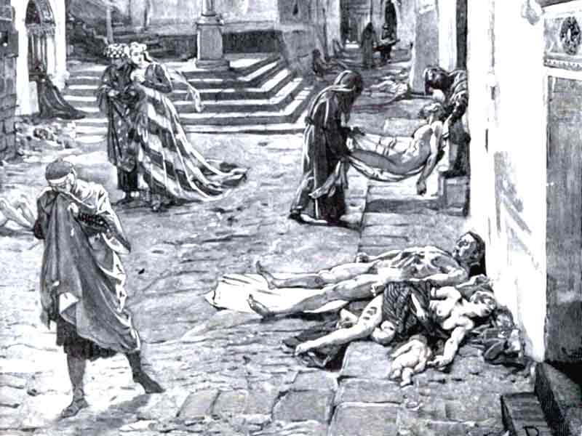
At first black death wasn’t recognize as a major threat to people but in the 6th century, But Then Everybody was starting to get affected

Slide 7
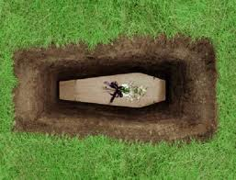
People with black death usually bury their self because they knew their were going to die.

Slide 8
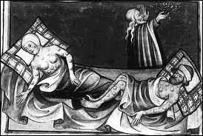
The deadly disease has killed nearly 200 million lives.

Slide 9
A cure was never found. People did not realize that the plague was caused by fleas hosted by the rats.

Slide 10
Black Death started to disappear when winter headed there way.

Slide 11
Information From :
Www.Google.com
Www.yahoo.com
Www.Answers.com

