Slide 1
The bird flu!!!
Raman Jwad

Slide 2
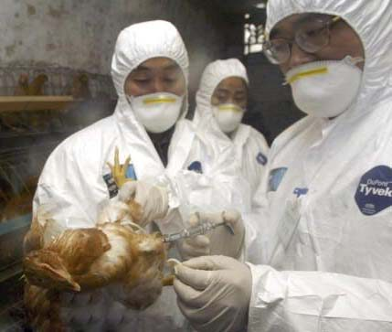
What is bird flu . Overview
H5N1 is also the most common form of bird flu. Not only is it deadly to birds, but it can easily affect humans and other animals who come in contact with a carrier. H5N1 was first discovered in humans in 1997, and has killed nearly 60 percent of those infected. An extremely deadly strain of bird flu, H5N1, continues to spread among poultry in Egypt, as well as certain areas of Asia.

Slide 3
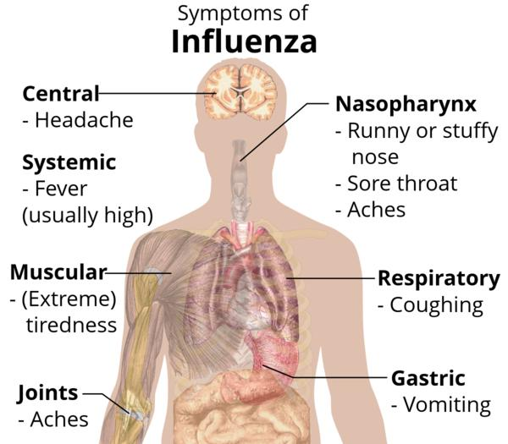
Bird flu symptoms
You may have H5N1 if you experience typical flu-like symptoms that may include:
cough
diarrhea
respiratory difficulties
fever (over 100.4°F)
headache
muscle aches
malaise
runny nose
sore throat

Slide 4
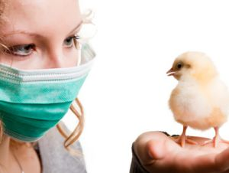
What are Causes of Bird Flu
Consuming properly cooked poultry or eggs from infected birds does not transmit the bird flu, but eggs should never be served runny. Meat should be considered safe if cooked to an internal temperature of 165º F.

Slide 5
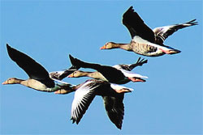
What are Bird Flu Risk Factors
You may have a greater risk of contracting H5N1 if you are:
a poultry farmer
a traveler visiting affected areas
exposed to infected birds
someone who eats undercooked poultry or eggs
a healthcare worker caring for infected patients
a household member

Slide 6
How is Bird Flu Diagnosed?
Your doctor may also perform the following tests:
white blood cell differential
auscultation (a test that detects abnormal breath sounds)
nasopharyngeal culture
chest X-ray

Slide 7
How do you treat Bird flu
In most cases, treatment with antiviral medication, such as oseltamivir or zanamivir can help reduce the severity of the disease. However, the medication must be given within 48 hours after the first symptoms appear. As a preventive measure, your family or other household members might also be prescribed Tamiflu, even if they are not sick.

Slide 8
What is the Long-Term Outlook For Someone Infected With Bird flu?
\
Some possible complications you might encounter are:
sepsis
pneumonia
organ failure
acute respiratory distress

Slide 9
How is Bird Flu Prevented?
The Centers for Disease Control and Prevention has issued no recommendations against traveling to countries that are affected by H5N1. However, avoiding the following can minimize your risk:
open air markets
contact with infected birds
undercooked poultry

Slide 10
Where did found the information?
http://health.yahoo.net/health/avian-influenza
Also there’s video
http://www.youtube.com/watch?v=8KRZWwjAQLA

Slide 11
When was the bird flu?
It was in 28 January-2004

