Slide 1
Bird Flu
By Rand Jwad

Slide 2
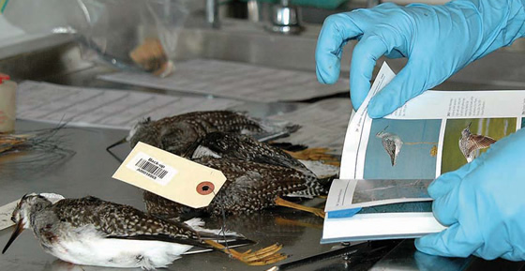
What is bird flu?
1)It is a virus
2)It can cause illness in people and animals
3) It is common in South East Asia
4) It is commonly called “Bird Flu”.

Slide 3
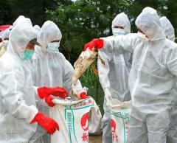
What causes Bird Flu?
is caused by a kind of influenza virus
Birds and eggs are sold in crowded and unsanitary conditions
This disease is transmitted via contact with infected bird’s feces like eyes and mouth .

Slide 4
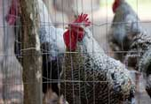
Bird Flu Treatment
The small number of human cases have not been to conduct treatment trials for bird flu

Slide 5
Symptoms
Coughing
fever
diarrhea
fiddicalt to breath
headache
Sore throat
That’s what you feel when you have the bird flu.

Slide 6
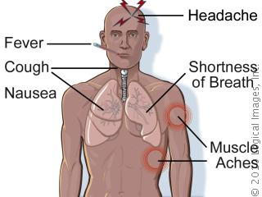
symptoms

Slide 7
How does bird flu spread among birds
Other birds can get the bird flu when they have close contact with infected birds and the babies of the birds can also get it and its hard to birds to get rid of it and it could kill the birds.

Slide 8
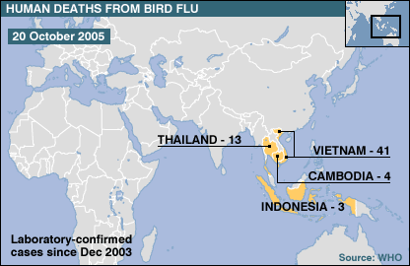
Where does it come from?
The first historical cases of avian flu were identified in Europe

Slide 9
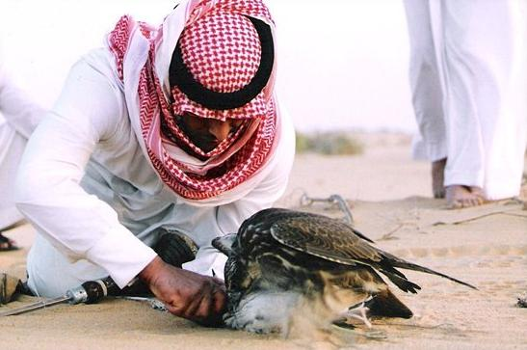
Vector-Borne
Birds have the potential to transmit disease to humans. Pests that transfer diseases are referred to as a
The vector picks up the disease organism from an infected host, an animal or a human vector

Slide 10
http://www.youtube.com/watch?v=A1aULNCoDe0
http://www.youtube.com/watch?v=Ia8Jk5Avt-A

Slide 11
Bibliography
www.google.com
www.yahoo.com
www.youtube.com

