Slide 1
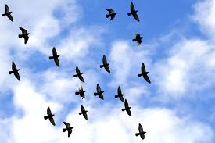
Bird flu

Slide 2
The history of bird flu
In 1918, the Spanish flu started off as a normal human influenza virus took a terrible turn and became terribly lethal. This was the first major flu pandemic of the 20th century. Scientists believe that this virus was a mutated form of a bird flu virus.

Slide 3
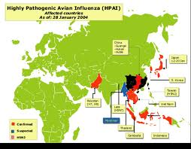
Avian influenza
bird flu, also called avian influenza, a viral respiratory disease mainly of poultry and certain other bird species, including migratory water birds, some imported pet birds, and ostriches, that can be transmitted directly to humans. The first known cases in humans were reported in 1997, when an outbreak in poultry in Hong Kong led to severe illness in 18 people, a third of whom died

Slide 4
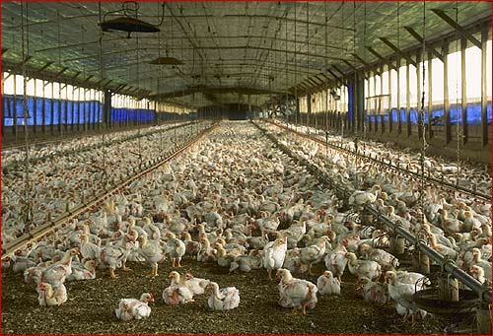
THOUSANDS of chickens from an egg farm near Maitland have been destroyed following a bird flu outbreak.

Slide 5
Bird flu in humans
From 2003 through December 2011, some 574 people were reported to have been infected with bird flu, and about 60 percent of them died.

Slide 6
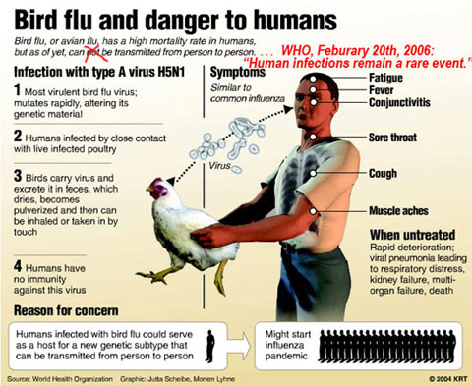
Subtypes of bird flu virus
Bird flu in avian species occurs in two forms, one mild and the other highly virulent and contagious; the latter form has been termed fowl plague. Mutation of the virus causing the mild form is believed to have given rise to the virus causing the severe form. The infectious agents of bird flu are any of several subtypes of type A orthomyxovirus.

Slide 7
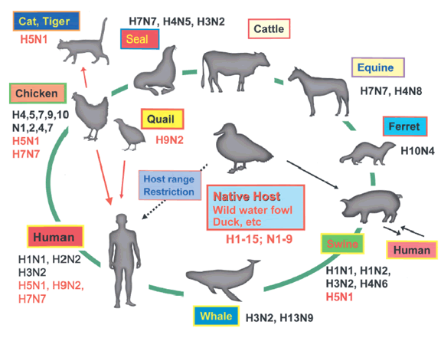
Other subtypes of this virus are responsible for most cases of human influenza and for the great influenza pandemics of the past. Genetic analysis suggests that the influenza A subtypes that afflict mainly no avian animals, including humans, pigs, whales, and horses, derive at least partially from bird flu subtypes.

Slide 8
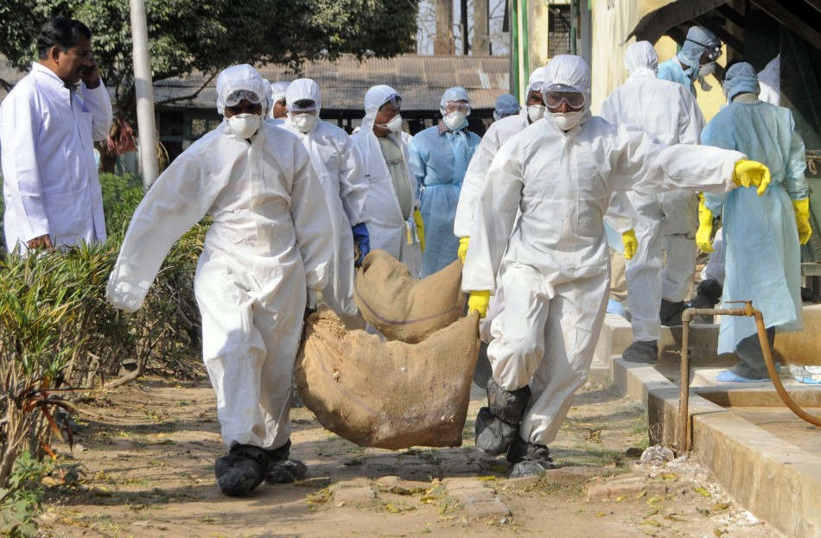
What did us do with bird flu
Attempts are made in the United States to minimize the presence of HPAI in poultry thorough routine surveillance of poultry flocks in commercial poultry operations. Detection of a HPAI virus may result in immediate culling of the flock. Less pathogenic viruses are controlled by vaccination, which is done primarily in turkey flocks (ATCvet codes: QI01AA23 for the inactivated fowl vaccine, QI01CL01 for the inactivated turkey combination vaccine).

Slide 9
Refrences:
Google research
Google images
Mather high school research

